Slide 1
Accessible Instructional Materials: Assessment Planning

Slide 2
Activity Overview
Explore the process of planning an instructional/learning media assessment.
Determine who should be involved.
Determine what assessment tools may be useful.
Reading assessments
Assistive technologies

Slide 3
Areas of Assessment
Determine what areas of assessment are needed:
Vision/Hearing
Is the student blind or visually impaired?
Is the student deaf or hard of hearing?
Physical
Does the student have fine or gross motor limitations that impact managing instructional materials?
Cognitive
Does the student have cognitive processing problems that impact understanding typical print or text?

Slide 4
Choose Assessment Tools
Vision/Hearing
To be determined by a vision or hearing teacher/specialist
Could include a variety of learning media assessments.
Supports include the staff at FIMC-VI and the staff at RMTC-DHH

Slide 5
Choose Assessment Tools
Physical
To be determined by a teacher, occupational therapist, physical therapist, or assistive technology specialist
Typical target assessments may include computer access choices, switch systems, and appropriate software to control instructional media on-screen
Equipment may need to be checked out of the state loan library to evaluate.

Slide 6
Choose Assessment Tools
Cognitive
To be determined by a reading coach, teacher, learning disability specialist, assistive technology specialist, or a technology specialist
May be a complex area of assessment due to the number of issues that could be addressed
Highest incidence of assessments

Slide 7
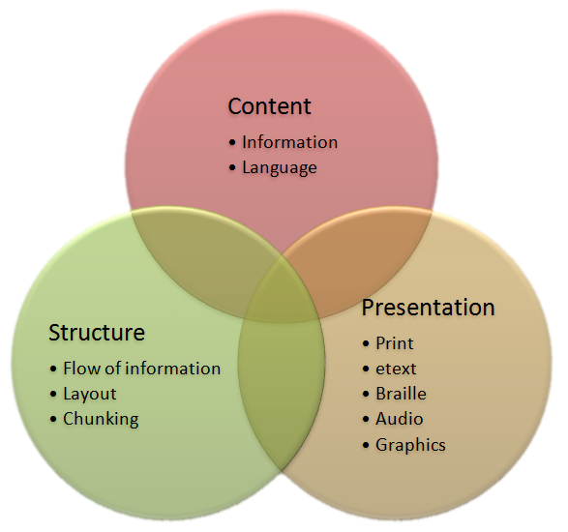
Target Considerations

Slide 8
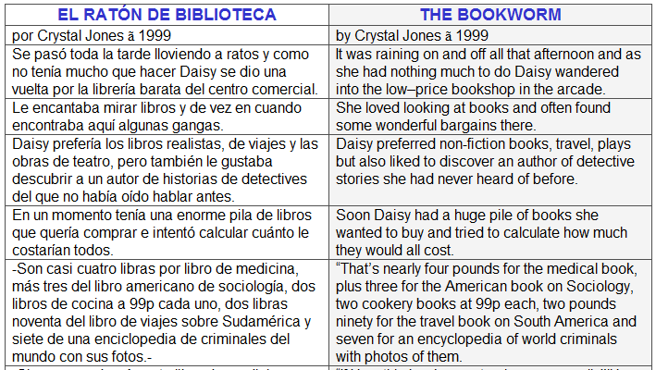
Content
http://www.englishspanishlink.com/stories_and_poems.htm

Slide 9


Content
http://www.windows2universe.org/

Slide 10
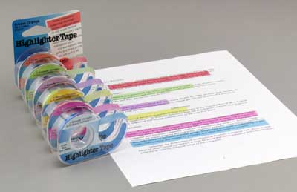
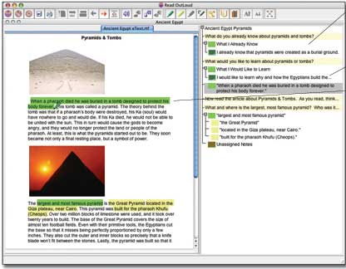
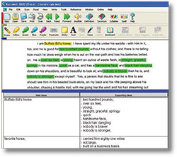
Structure

Slide 11
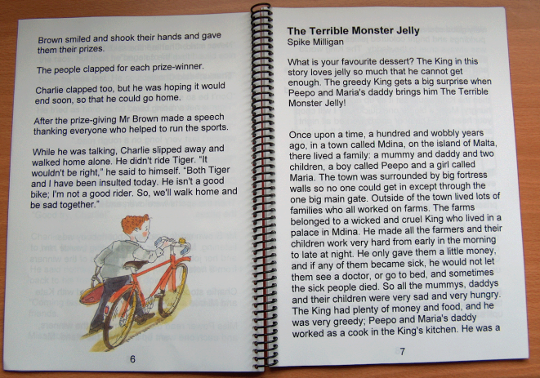
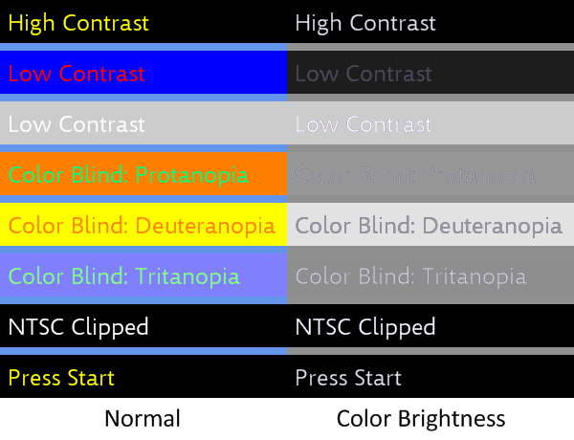
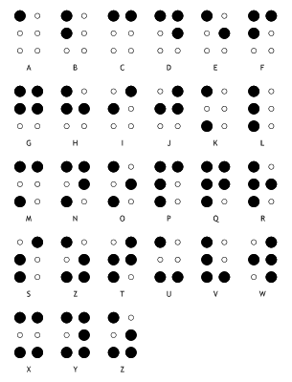

Presentation

Slide 12
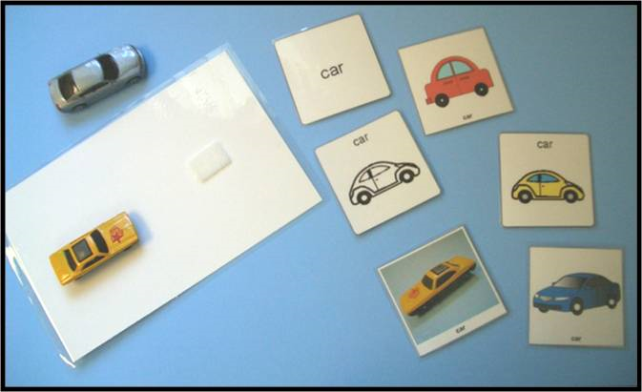
Presentation
http://www.sc.edu/scatp/aacsymbols.html

Slide 13

Overview of the Assessment Planning Form

Slide 14
Next Steps
Fill out the Assessment Planning Form.
Optional Exploration
AIM Explorer Software
San Diego Quick Assessment
Pearson Online Reading Assessment
Digital Tool Tutorials

Slide 15
Accessible Instructional Materials Assessment Planning

