Slide 1
Accessible Instructional Materials Basics

Slide 2
Instructional Materials
Core
Information
Manipulatives

Slide 3

Instructional Materials
Core
Information
Manipulatives
Textbooks and related core materials published with the texts
Required by the Florida Dept. of Education or the school district
Described by FDOE as “major instructional tools”
Core instructional materials may be printed to paper, digital files, ebooks, web-based, or a combination

Slide 4
Instructional Materials
Core
Information
Manipulatives
Information, reading, and research materials not considered “major instructional tools” but used by the school and classroom teachers
Examples include encyclopedias, dictionaries, reference materials, content enhancement materials, novels, periodicals, videos, etc.
Informational materials may be printed to paper, digital files (pdf, PPT, etc.), ebooks, web-based, or a combination

Slide 5
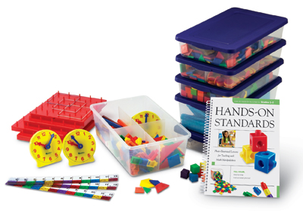

Instructional Materials
Core
Information
Manipulatives
Manipulatives include those items that are universally used as curriculum instruction & learning aids, such as math manipulatives and science lab equipment.

Slide 6
Accessibility
To be accessible, instructional materials must be:
Perceivable: If the material is audio the student must be able to hear it. If it is visual the student must be able to see it.
Operable: The student must be able to physically manage the materials.
Understandable: The student must be able to understand how to use the materials and be able to understand the content.
http://www.w3.org/TR/UNDERSTANDING-WCAG20/intro.html

Slide 7
Who can benefit?
Students who cannot decode text and/or have language-related disabilities have shown positive effects for fluency with text-to-speech.
Students with attention, organizational, and/or learning disabilities have shown improved academic gains with visual mapping supports, such as concept mapping.
Students who cannot hold a printed book or turn the pages benefit from digital books where the pages can be “turned” by a switch or key press.
Students who are deaf or hard-of-hearing have demonstrated academic gains with sequential text highlighting and captioning.
Students who are blind or visually impaired benefit from digital text that can be converted to braille, used by refreshable braille displays, or converted to audio.

Slide 8
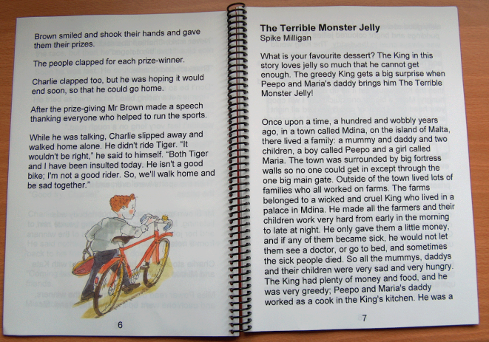
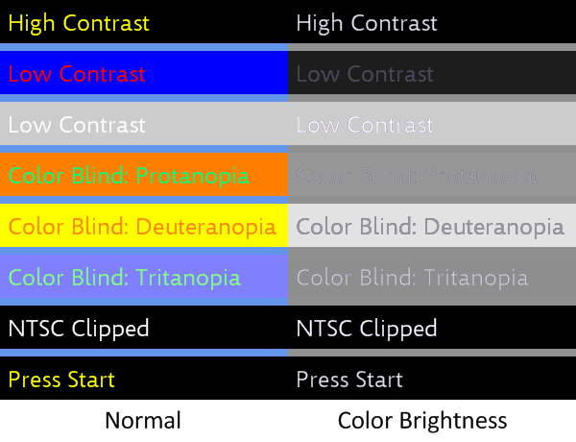
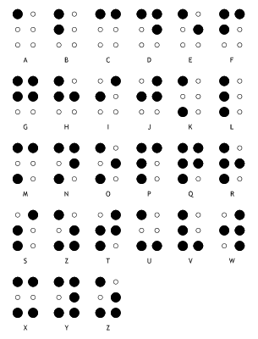

AIM

Slide 9
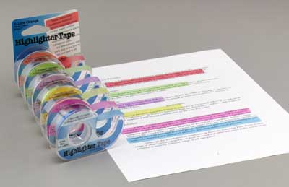
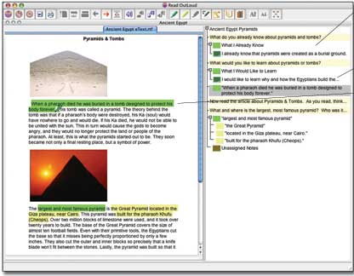
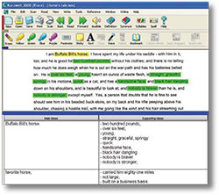
AIM

Slide 10
Legal Requirements
IDEA 2004
“ . . the SEA must ensure that all public agencies take all reasonable steps to provide instructional materials in accessible formats to children with disabilities who need those instructional materials at the same time as other children receive instructional materials.”
CFR 300.172 (b)(4)

Slide 11
FAPE
Federal Register Vol 71, No. 156, Pg. 46618
“Timely access to appropriate and accessible instructional materials is an inherent component of a public agency’s obligation under the Act to ensure that FAPE is available for children with disabilities and that children with disabilities participate in the general curriculum as specified in their IEPs.”

Slide 12
AIM

Slide 13
AIM

Slide 14
Next Steps
Optional Exploration
Florida AIM Technical Assistance Paper
Florida NIMAS Technical Assistance Paper
National AIM Website
AIM section from the Exploring New Territories booklet

Slide 15
Accessible Instructional Materials Basics

