Slide 1
The NIMAS Sourcing Puzzle
Sourcing
Specialized Formats for
NIMAS-Eligible Students

Slide 2
Strategies for Solving Puzzles
Create a clear work area
Turn pieces face up
Don’t accidentally lose a piece of the puzzle
Select edge pieces and assemble
Separate pieces into color groups
Partially assemble objects in the puzzle
Identify redundancy
Place the assembled objects in the approximate locations
Don’t force the pieces to fit

Slide 3
Create a Clear Work Area
Student Eligibility and Textbook Criteria

Slide 4


Student Eligibility and Textbook Criteria

Slide 5

Student Eligibility
Digital Rights Managers (DRMs) - NIMAS/Florida
http://www.fimcvi.org/articlepdfs/NIMAS_DRM_Training%201%206%20R.pdf
Hands On NIMAS Florida: The journey continues
http://techfunction10.wikispaces.com/file/view/Hands+On+NIMAS+Florida+power+point+06+10.pdf
Notes:
Use of these NIMAS derived materials with students that are not eligible would be considered an infringement of copyright.

Slide 6
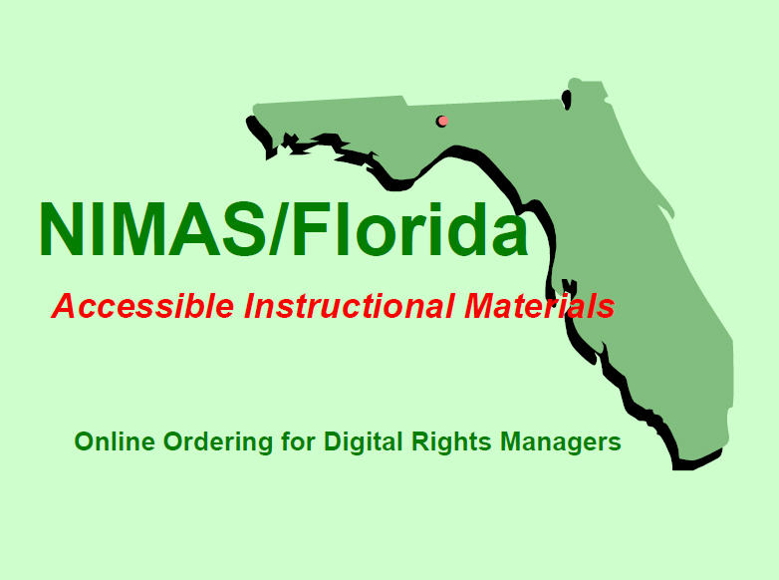
Digital Rights Managers (DRMs)
NIMAS/Florida Training
This presentation provides detailed guidance on Student Eligibility and Criteria for textbook inclusion in NIMAC.
Notes:
http://www.fimcvi.org/articlepdfs/NIMAS_DRM_Training%201%206%20R.pdf

Slide 7
Student Eligibility
In Brief:
Must have an Individualized Educational Plan (IEP) according to IDEA that addresses Specialized Formats
Must also meet the eligibility requirements to qualify for exemption to the Copyright Act defined under the Chafee Amendment
Certified by Competent Authority as Blind, Visually Impaired, or having Physical Limitations.
Certified by Competent Authority as having a Print Disability or Reading Disability from Organic Dysfunction.
Notes:
Only 1%-2% of the student population qualifies.
What is “organic dysfunction?”

Slide 8
Student Eligibility
National Library Service for the Blind and Physically Handicapped (NLS) and Public Law 89-522
http://www.loc.gov/nls/reference/factsheets/readingdisabilities.html
Applications for service from individuals claiming a reading
disability based on a physical handicap must establish the
following facts:
• the reading disability must be of sufficient severity to prevent reading regular or standard printed material in a normal manner,
• the cause of the disability must be physically based, that is, it must be an organic dysfunction, and
• the person certifying the application must be medically able to judge whether the disability has a physical or organic basis.

Slide 9
Textbook Criteria
Usually NOT Available:
Older copyrights of core instructional material(s)
Only electronic files of book titles published after August 2006 are required to be placed in the National Instructional Materials Access Center (NIMAC).
For instructional materials published prior to August 2006, the district is responsible for obtaining the materials in accessible formats.

Slide 10
Textbook Criteria
Not mandated, but sometimes available:
Ancillary or supplemental instructional material(s)
As described in IDEA, only core instructional materials are required to be placed in the National Instructional Materials Access Center (NIMAC)
For ancillary or supplemental instructional materials, the district is responsible for obtaining the materials in accessible formats.

Slide 11
Turn pieces face up
Evaluations and Diagnostic Testing
Notes:
Do you know what you are looking for?

Slide 12
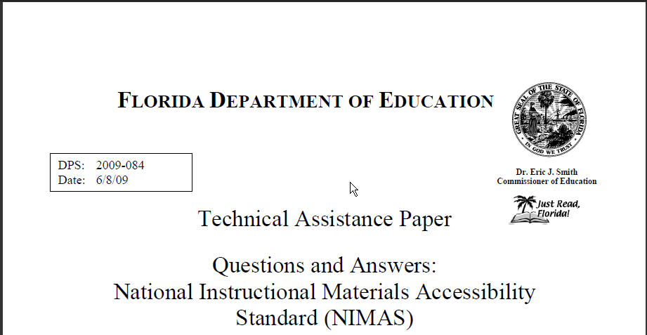
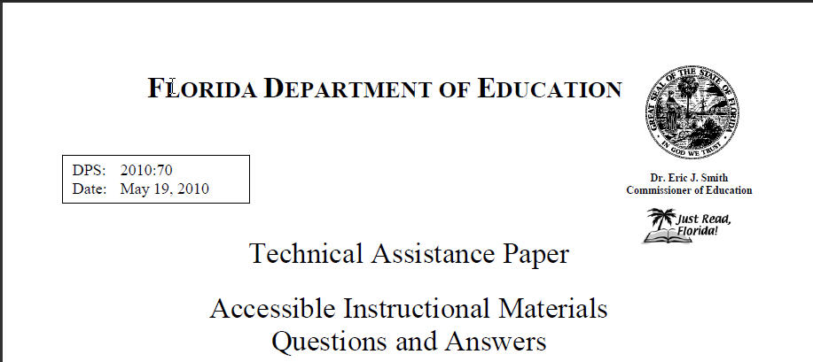
Evaluations and Diagnostic Testing
NIMAS and AIM Technical Assistance Papers (TAPs) provide guidance on how to determine if a student is unable to read standard print effectively due to their disability.
NIMAS TAP: AIM TAP:
Notes:
http://info.fldoe.org/docushare/dsweb/Get/Document-5424/dps-2009-084.pdf
http://info.fldoe.org/docushare/dsweb/Get/Document-5764/dps-2010-70.pdf

Slide 13

Evaluations and Diagnostic Testing
The IEP team should gather information using
evaluation
student progress monitoring
diagnostic educational testing
to determine if the student requires specialized formats.

Slide 14
Don’t accidentally lose a piece of the puzzle
Preparation
Notes:
Or, don’t make promises that you can’t keep.

Slide 15
Preparation
Is the student unable to read print material in a normal manner?
Is the student certified as print-disabled by a competent authority?
Is the specialized format appropriate for the student?
Is the specialized format specified in the IEP?
Notes:
These questions build the basic framework. If the student isn’t eligible, remember that the sourcing skills you learn today can still be applied to help locate Accessible Instructional Materials.

Slide 16
Preparation
Some helpful documents can be found in both PDF and Word at:
Sample NIMAS Qualifying Information
Sample NIMAS Student Registration Form
Sample Physicians Certification Form
http://www.fimcvi.org/index_files.cfm?category=40

Slide 17
Select edge pieces and assemble
The Individualized Educational Plan (IEP)

Slide 18

Hands On NIMAS Florida:
The journey continues
This presentation provides detailed guidance on the IEP.
Notes:
Wonderfully detailed presentation.
http://techfunction10.wikispaces.com/file/view/Hands+On+NIMAS+Florida+power+point+06+10.pdf

Slide 19

We Now Have the Frame of the Puzzle
Notes:
Having gathered and documented this information, it now needs to be provided to the DRM for student registration and ordering purposes.

Slide 20
Separate pieces into color groups
International Standard Book Numbers (ISBN)
Notes:
So, at last, we begin to search for books.

Slide 21
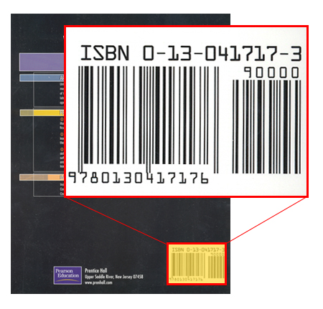
International Standard Book Numbers (ISBN)
ISBN Tips and Tricks
The ISBN identifies one title or edition of a title
The ISBN can be found on the lower portion of the back cover of a book above the bar code and on the copyright page.
Notes:
http://www.fimcvi.org/articlepdfs/ISBN%20Tips%20and%20Tricks%2006%2001%2010%20Arial.pdf

Slide 22

International Standard Book Numbers (ISBN)
BUT . . . Is it . . .
The Teacher’s Edition?
An Examination Copy?
A 1982 Copyright?
A Paperback?
One of a Set?
Which one is which? So . . . .
Notes:
When searching for an ISBN, school–based staff members often give the District Digital Rights Manager (DRM) the ISBN of the book that is sitting on top of their desk at the time. That version of the textbook may be a Teacher’s Edition of the textbook or an Examination Copy of the textbook given to the school by the publisher’s representative. In either situation, the ISBN would be different than the ISBN of the Student Edition of the textbook!

Slide 23
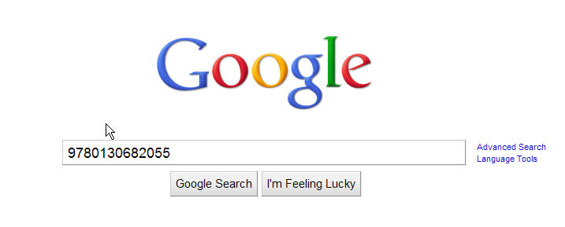
International Standard Book Numbers (ISBN)
Scenario #1
Notes:
Scenario #1

Slide 24
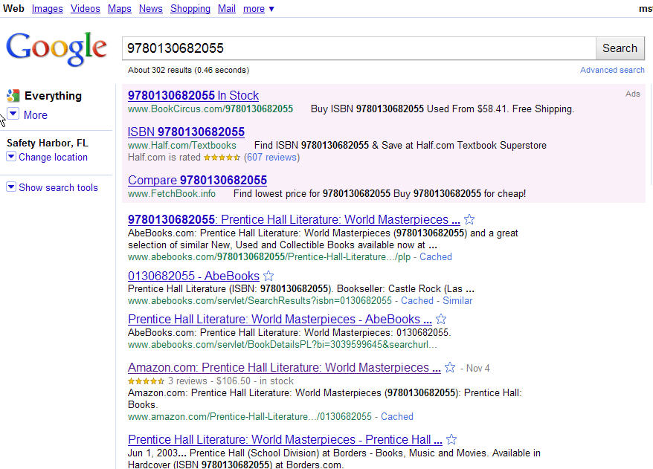
International Standard Book Numbers (ISBN)
Notes:
Results from Amazon or Barnes and Noble will provide lots of data about the book.

Slide 25
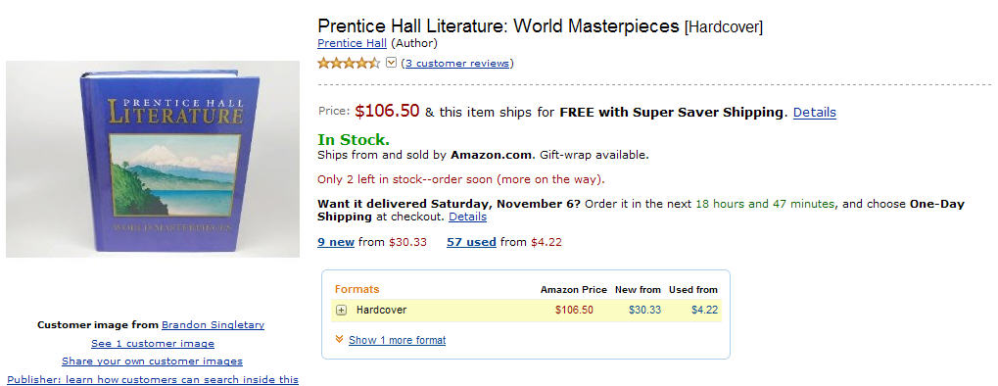
International Standard Book Numbers (ISBN)
Amazon
Notes:
Scenario: 9780130682055 Not found at NIMAC. No copyright date provided by school staff. Search by Title shows an alternate by searching for title “Prentice Hall Literature World Masterpieces” at NIMAC.

Slide 26
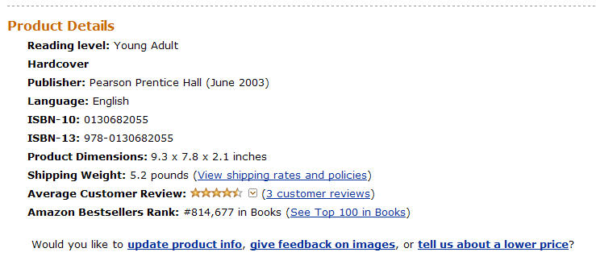
International Standard Book Numbers (ISBN)
Amazon
Notes:
Copyright Date information found for 9780130682055.

Slide 27
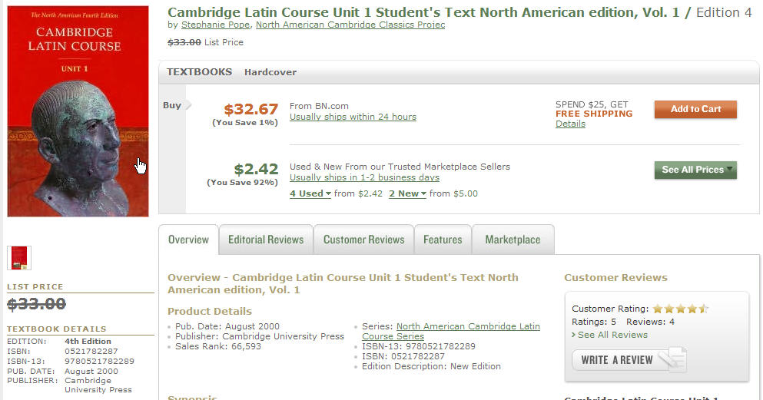
International Standard Book Numbers (ISBN)
Barnes & Noble
Notes:
Copyright Date information found for Cambridge Latin.

Slide 28
International Standard Book Numbers (ISBN)
Notes:
Every piece of information gets us closer to providing the required materials, so now we can look at NIMAC.

Slide 29
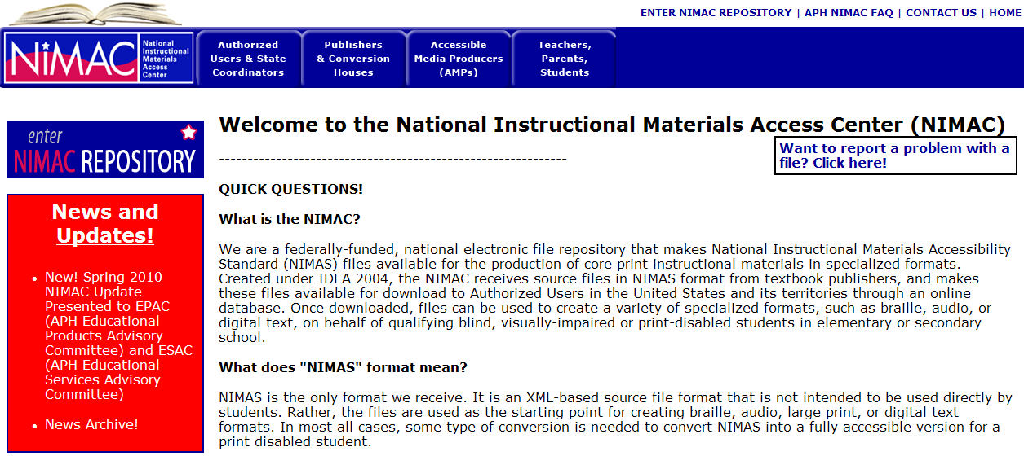
International Standard Book Numbers (ISBN)

Slide 30
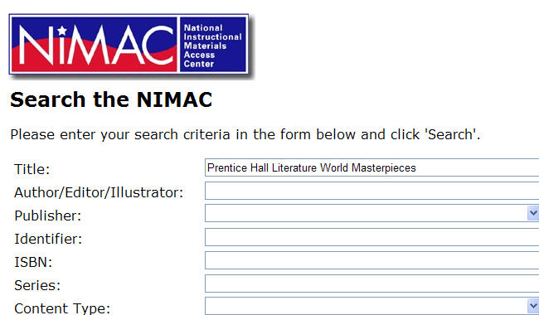
International Standard Book Numbers (ISBN)
Notes:
In NIMAC by searching for title Prentice Hall Literature World Masterpieces 9780130682055 alternate available

Slide 31
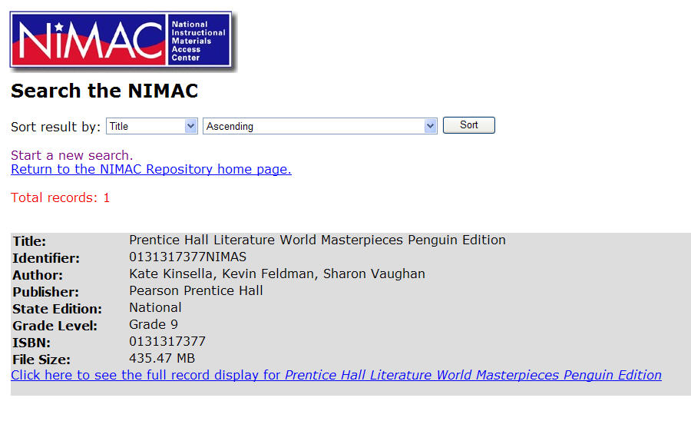
International Standard Book Numbers (ISBN)
Penguin?
Notes:
9780130682055 alternate available in NIMAC by searching for title Prentice Hall Literature World Masterpieces, but is it the same book?

Slide 32
International Standard Book Numbers (ISBN)
If needed, GOOGLE it, again!
To Verify and Obtain Detailed Information
For the alternate ISBN 0131317377

Slide 33

International Standard Book Numbers (ISBN)
Amazon
Notes:
9780130682055 alternate available in NIMAC by searching for title Prentice Hall Literature World Masterpieces

Slide 34
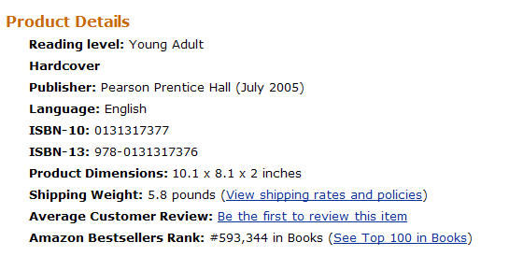
International Standard Book Numbers (ISBN)
Amazon
Notes:
Newer Version

Slide 35
International Standard Book Numbers (ISBN)
Notes:
Every piece of information gets us closer to providing the required materials. Let’s try at RFB&D for audio versions.

Slide 36
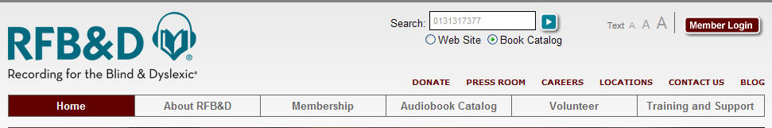
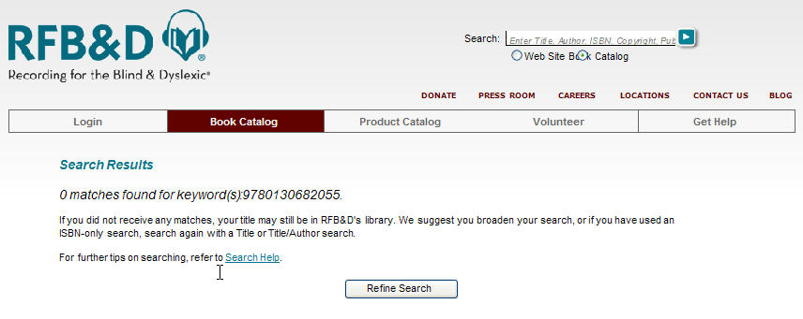
International Standard Book Numbers (ISBN)
If
No Match
Notes:
RFB&D Home page search function is located on all pages, but if it is not found, you have to go deeper in to the site.

Slide 37
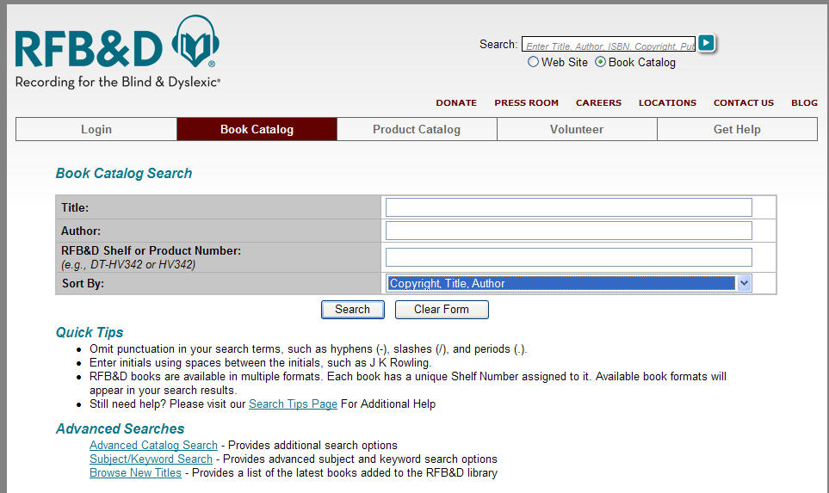
International Standard Book Numbers (ISBN)
Notes:
The first search level doesn’t allow for an ISBN search. Go to Advanced.

Slide 38
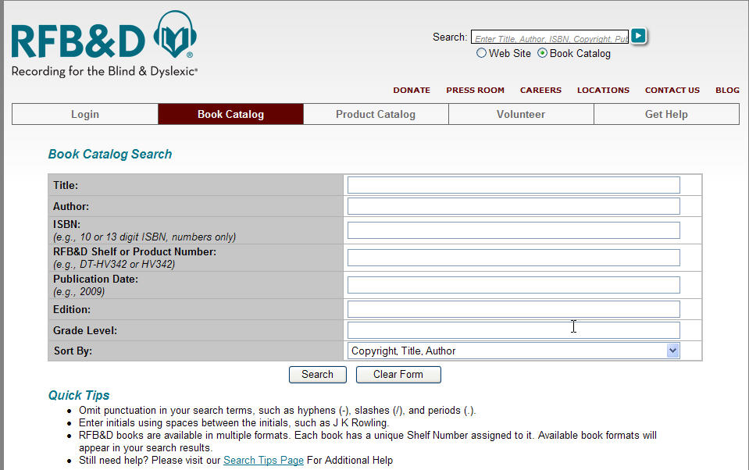
International Standard Book Numbers (ISBN)
Notes:
Advanced search to use ISBNs.

Slide 39
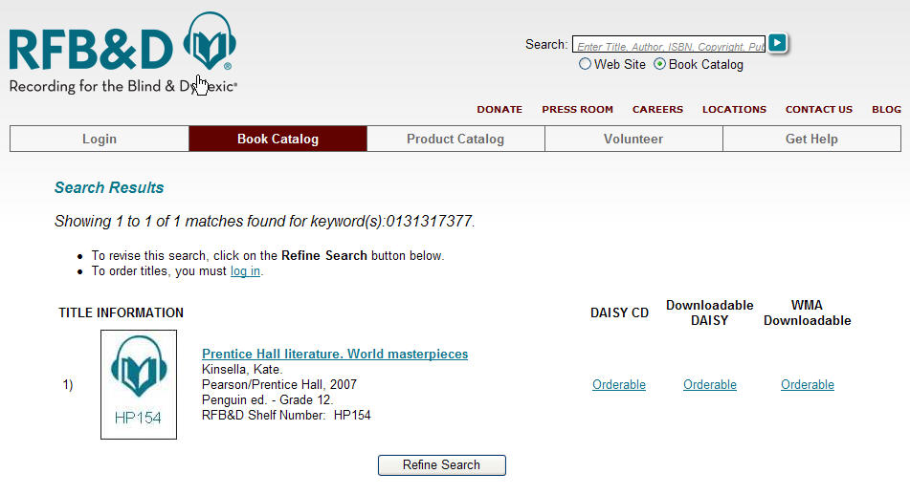
International Standard Book Numbers (ISBN)
Notes:
Order it, or get more details.

Slide 40
International Standard Book Numbers (ISBN)
Notes:
More details by clicking on the title.

Slide 41
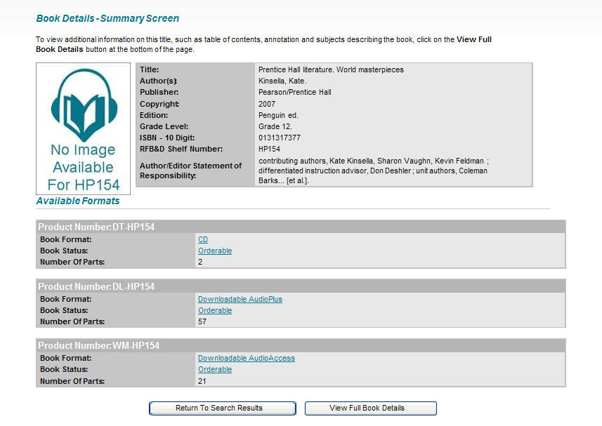
International Standard Book Numbers (ISBN)
Notes:
Shows number of parts.

Slide 42
International Standard Book Numbers (ISBN)
Notes:
Every piece of information gets us closer to providing the required materials. Move to another scenario.

Slide 43
International Standard Book Numbers (ISBN)
Ready for Another Scenario?
#2
GOOGLE
ISBN 9780021947294
Notes:
School Staff has ISBN 9780021947294 Copyright 2009. And they only provided Triumphs as a title. Should be at NIMAC, right? Not there! Found at Amazon.

Slide 44

International Standard Book Numbers (ISBN)
Amazon
Notes:
School Staff has ISBN 9780021947294 Copyright 2009. Should be at NIMAC, right? Found at Amazon.

Slide 45
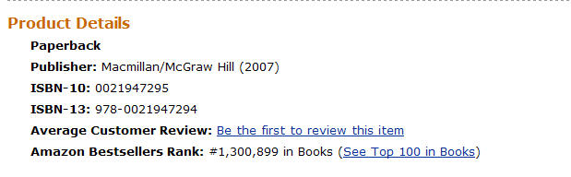
International Standard Book Numbers (ISBN)
Amazon
Notes:
School Staff has ISBN 9780021947294 Copyright 2009. Should be at NIMAC, right? Found at Amazon, but it says copyright 2007.
It might be an Ancillary, but before we go looking at the State Adopted Catalog, let’s try the 10 Digit ISBN 0021947295 at NIMAC.
0021947295

Slide 46
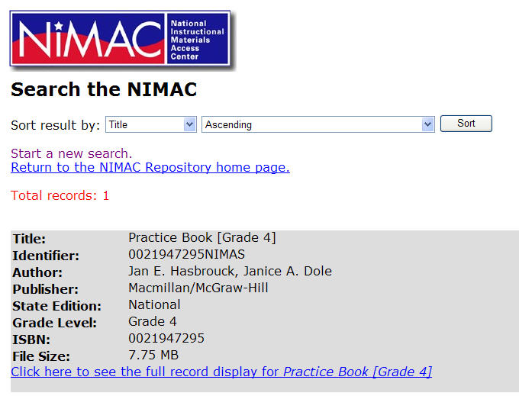

International Standard Book Numbers (ISBN)
Notes:
School Staff has ISBN 9780021947294 Copyright 2009. Should be at NIMAC, right? Found at Amazon. Found at NIMAC using the 10 Digit ISBN.

Slide 47
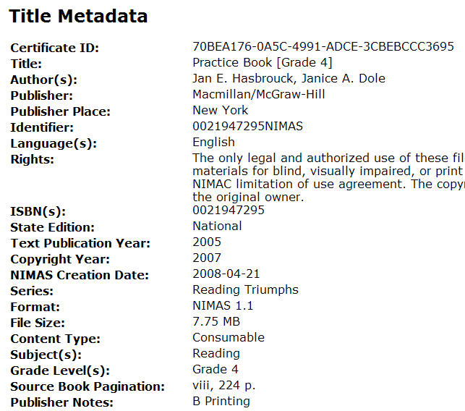
International Standard Book Numbers (ISBN)
Notes:
A little more useful detail.

Slide 48
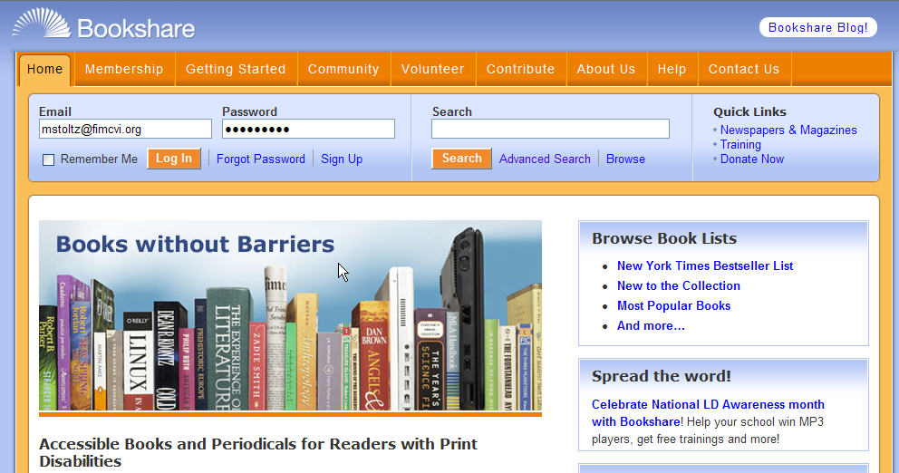
International Standard Book Numbers (ISBN)
Notes:
Since I have a good chance of finding it, I login at Bookshare.

Slide 49
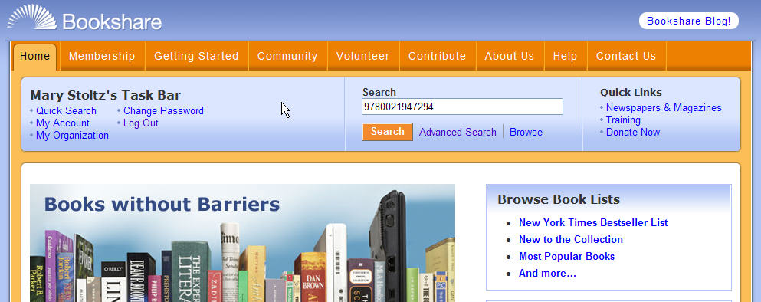
International Standard Book Numbers (ISBN)
Notes:
Enter the ISBN.

Slide 50
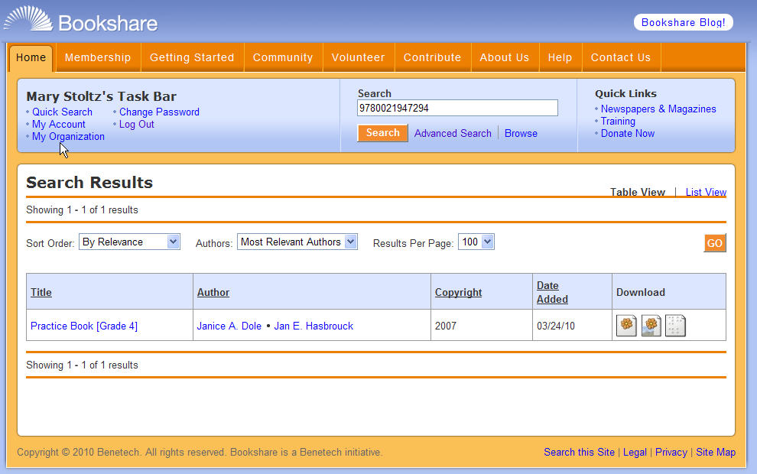
International Standard Book Numbers (ISBN)
Notes:
And there it is available for download. Which means that it is time for us to explore Electronic Formats.

Slide 51
Partially assemble objects in the puzzle
Electronic Formats

Slide 52
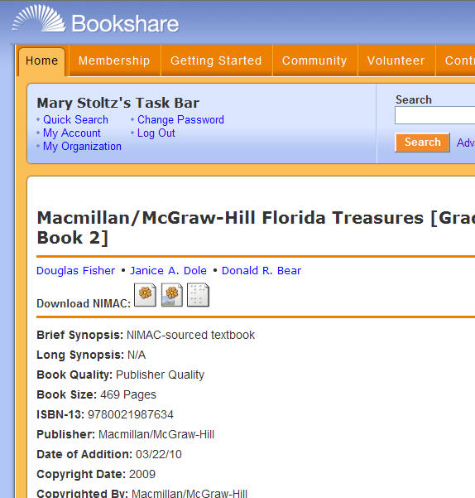
Electronic Formats
Bookshare
http://www.bookshare.org/
DAISY
DAISY with Images
BRF
Notes:
Bookshare provides three formats. They also have programs available for download to read the files, but we won’t be addressing that in this session.

Slide 53
Electronic Formats
DAISY as a base for other formats
May be converted by the student’s Assistive Technology
May be converted by Technical Support Personnel

Slide 54
Electronic Formats
Recordings for the Blind and Dyslexic (RFB&D)
AUDIOPLUS
On CD or Downloadable
Available on CD for use with DAISY players
Each page of the book is navigated by track.
AudioAccess
Downloadable
Does not require specialized playback equipment
Plays on Windows computers
Syncs with Windows portable media players
http://www.rfbd.org/

Slide 55
Electronic Formats for Purchase
HTML
Publishers “Market Model”
One example:
Pearson HTML BOOKS
Notes:
http://www.pearsonschool.com/index.cfm?locator=PSZ4Z4&PMDbProgramId=67381&PMDbSiteId=2781&PMDbSolutionId=6724&PMDbSubSolutionId=6732&PMDbCategoryId=806

Slide 56
Electronic Formats
Notes:
Every piece of information gets us closer to providing the required materials. It is time to examine what this means in terms of choices.

Slide 57
Identify redundancy
CDs, Online Versions, National Editions

Slide 58
CDs, Online Versions, National Editions
The CD version of the materials which can be read on the computer screen may be sufficient for students who do not need the navigational capabilities, e.g., ability to highlight words, mask sections of the screen, etc.
Notes:
Think about DVDs considering the size of books.

Slide 59

CDs, Online Versions, National Editions
Are the materials available on CD?
Often CD versions are “bundled” with the purchase of the materials so ESE staff may want to check with subject area or curriculum contacts at school or district level.
Search the Catalog of Florida State Adopted Instructional Materials
Search the Florida School Book Depository

Slide 60
CDs, Online Versions, National Editions
Catalog of Florida State-Adopted Instructional Materials at
https://www.fldoe.org/BII/instruct_mat/catalog1.asp
https://app1.fldoe.org/BII/Instruct_Mat/InstMatCatalog/
PDF Files in the Catalog of Florida State-Adopted Instructional Materials
social5.pdf
Notes:
Opens the PDF file during presentation, if time allows.

Slide 61
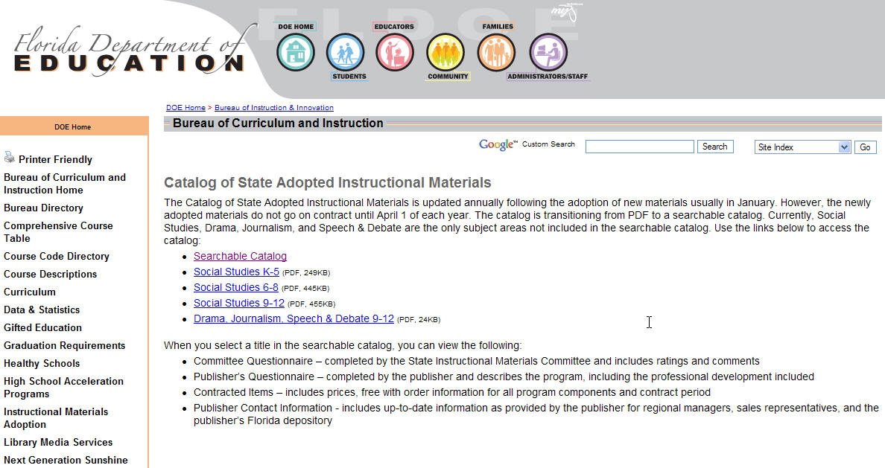
CDs, Online Versions, National Editions
Notes:
You may need to check the PDFs for some titles.

Slide 62
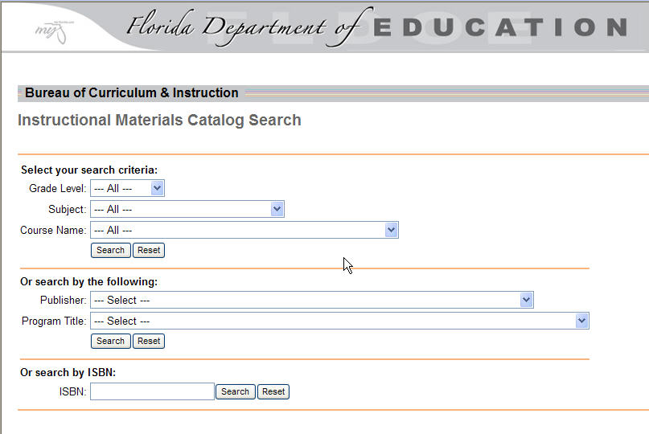
CDs, Online Versions, National Editions
Notes:
You can search by Grade Level, Subject, Course Name, etc., but by using Google you are assured that you have the correct ISBN before accessing this catalog. That narrows the parameters.

Slide 63
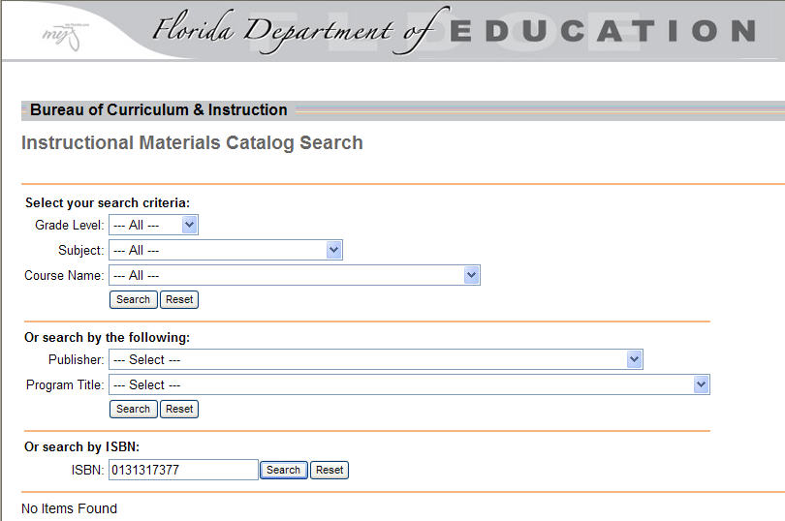
CDs, Online Versions, National Editions
Notes:
Source for 0131317377

Slide 64
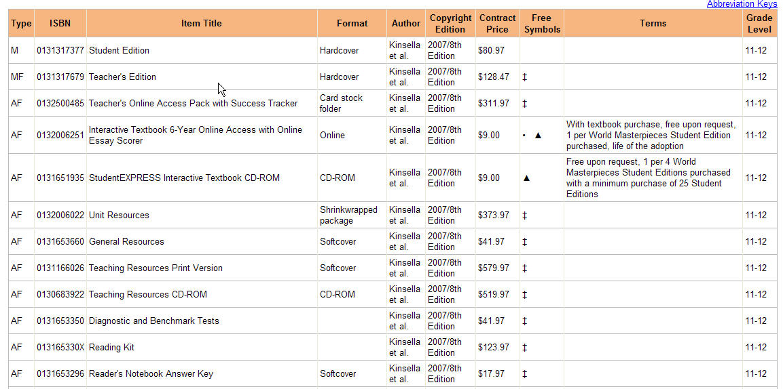
CDs, Online Versions, National Editions
Notes:
Online and Interactive CD-ROM. The price is right! Free!

Slide 65
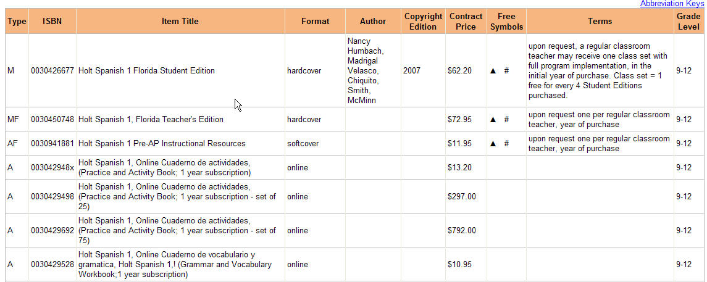
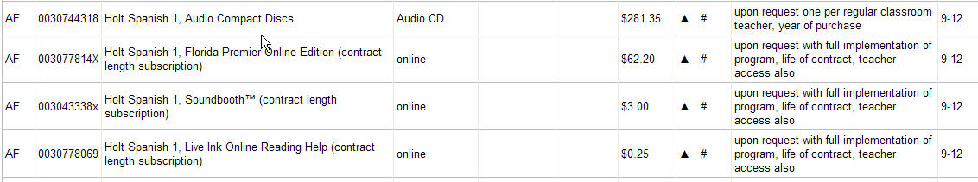
CDs, Online Versions, National Editions
Notes:
Sources for 003077814X. Online version same price as hardcover textbook. 0030426677 Expresate.

Slide 66
CDs, Online Versions, National Editions
Florida School Book Depository
http://www.fsbd.com
Notes:
Search by title, publisher, subject or ISBN.

Slide 67
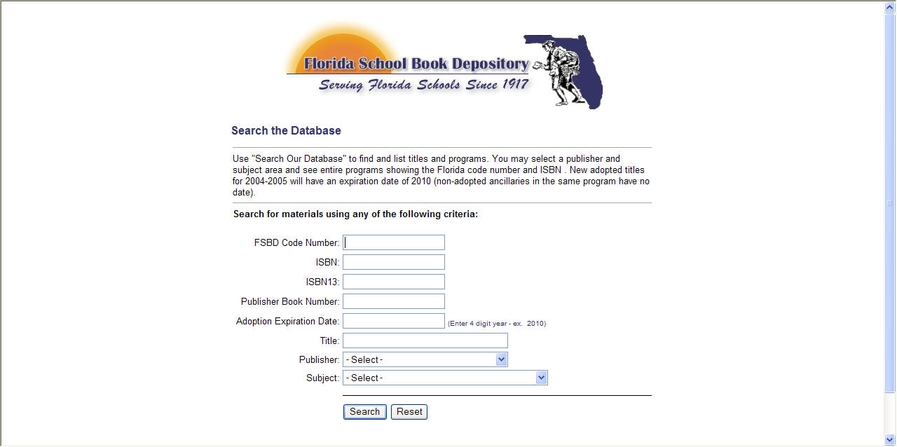
CDs, Online Versions, National Editions
Florida School Book Depository
http://www.fsbd.com/browse_search.asp

Slide 68
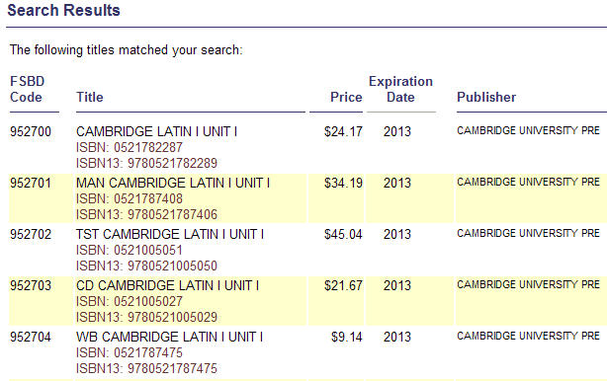
CDs, Online Versions, National Editions
Notes:
Search by publisher, Cambridge University Press, Latin. It is a state adopted book. Find FSBD Code. 9780521782289. These books are available as NIMAC derived materials at Bookshare, RFB&D.

Slide 69
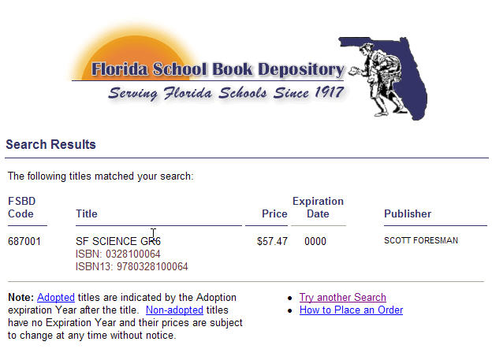
CDs, Online Versions, National Editions
Notes:
Search by ISBN 0328100064. See if it is a state adopted book. If not, Expiration date will be 0000. It is available at NIMAC, though. Compare title truncations.

Slide 70
CDs, Online Versions, National Editions
Notes:
Every piece of information gets us closer to providing the required materials. Transition to Publishers as sources. CDs, Online, National Editions.

Slide 71
Other Options?
If the materials are not available from other sources, how will they be provided?
Plan Ah
ead
Notes:
However, based on Special Order Requests we have received, this needs to be considered, as well.

Slide 72
Publishers as Sources

Slide 73



Publishers as Sources
Are the materials available online?
Examples:
Notes:
http://holtmcdougal.hmhco.com/hm/detail.htm?ID=1007500000077315#
http://www.eharcourtschool.com/tabnav/controller.jsp?isbn=9997455878
https://www.mheonline.com/program/view/4/1/116/002RT/121/0021921555/

Slide 74
Publishers as Sources
Contact publishers directly to request an accessible version of needed core instructional and supplemental materials
Web based html version
Locked/unlocked PDFs
CD version
Notes:
Many publishers have online request forms on their websites which can be downloaded, completed, and sent back to publishers via email. Website can be searched for “copyright and permissions.”
Web based version not always available from publisher
How accessible are the PDF and CD versions?
Can the navigational features of student’s software be used with publisher’s CD version of the textbook, such as:
Ability to highlight,
mask sections of screen,
access talking dictionaries,
develop outlines, etc?
The adoption contract often requires publishers to distribute one textbook on CD for every 30 copies for print texts. Check the school closets!

Slide 75
Obtaining Permission
Publishers as Sources
Macmillan/McGraw-Hill/Glencoe
http://www.mhhe.com/catalogs/cust_serv/permissions.mhtml
Pearson/Prentice Hall http://www.phschool.com/about_pearson/rights.html
Houghton Mifflin Harcourt
http://customercare.hmhco.com/gratis/gratis-cs.html
Notes:
The Pearson site includes a form with questions regarding file security. These would be good questions to have answered in a district policy or set of procedures for digital files.
http://www.mhhe.com/catalogs/cust_serv/permissions.mhtml for Higher Ed only
Redirect: Houghton Mifflin Harcourt http://customercare.hmhco.com/gratis/gratis-cs.html

Slide 76
Place the assembled objects in the approximate locations
NIMAS/Florida and Other Links
Notes:
NIMAS/FL and links.

Slide 77
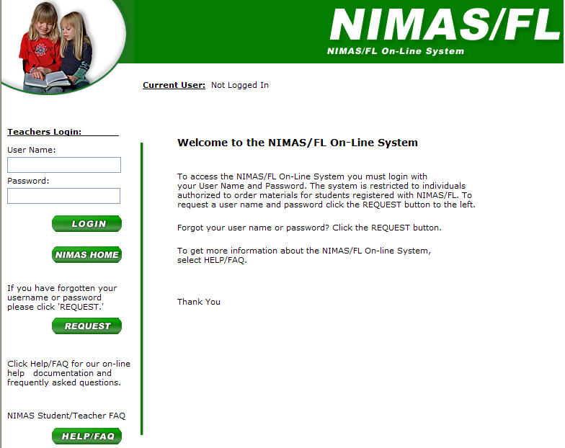
NIMAS/Florida and Other Links
NIMAS/Florida
Requires DRM Login
https://olo.sdhc.k12.fl.us/index2.asp
Notes:
https://olo.sdhc.k12.fl.us/index2.asp

Slide 78
NIMAS/Florida and Other Links
Bookshare
http://www.bookshare.org/
RFB&D
http://www.rfbd.org/
Project Gutenberg
http://www.gutenberg.org/wiki/Main_Page
AccessText Network
http://www.accesstext.org/

Slide 79
NIMAS/Florida and Other Links
Notes:
Almost finished.

Slide 80
Don’t force the pieces to fit
Copyright Protection

Slide 81
Copyright Protection
National Editions and other alternates
The contents of all books requested through NIMAS/Florida are protected under copyright law.
The DRM must also verify that there has been a copy of the standard print material(s) purchased for sole use by the student for each of the files and/or specialized formats being ordered.
Notes:
What about other states editions?

Slide 82
Copyright Protection
National Editions and other alternates
NIMAS/Florida strictly regulates its distribution of materials to individual students that documented evidence of a print disability.
Copying, sharing or redistributing NIMAS/Florida books in any format to any person other than the person the materials was requested is strictly prohibited by law and is a violation of publishers’ rights and of the terms of this agreement.
Violations will subject the school district to possible civil or criminal penalties.
Notes:
One book for one student.

Slide 83
The Puzzle is Complete

Slide 84

Final Thought . . .
The art of simplicity
is a puzzle of
complexity!
Douglas Horton
Notes:
“Sourcing” is indeed complex puzzle!

