Slide 1

Rebecca Sarlo, Ph.D.
Secondary Unit Coordinator
Shelby Robertson, Ph.D.
Learning and Development Facilitator of Mathematics
Pam Sudduth, M.A.
Learning and Development Facilitator of Literacy

Slide 2
Florida Transitions to
Common Core State Standards
NGSSS
CCSS
Standards-based instruction
Test item specifications guide development of curriculum maps
Focus mini-assessments aligned to individual benchmarks and used to monitor student progress
Teaching benchmarks in isolation results in long lists of tasks to master
Standards-based instruction facilitated by learning goals
Big ideas and learning goals guide the development of curriculum maps
Learning progressions or scales describe expectations for student progress in attaining the learning goals
Assessments used to monitor student progress are aligned directly to the learning progressions or scales
Teaching big ideas narrows the focus and allows students to delve deeper for a greater depth of understanding
Notes:
NGSSS – Next Generation Sunshine State Standards for English Language Arts and Mathematics were adopted between 2007 and 2008.
CCSS – Common Core State Standards for English Language Arts and Literacy in History/Social Studies, Science, and Technical Subjects were adopted by Florida’s State Board of Education in June 2010.

Slide 3
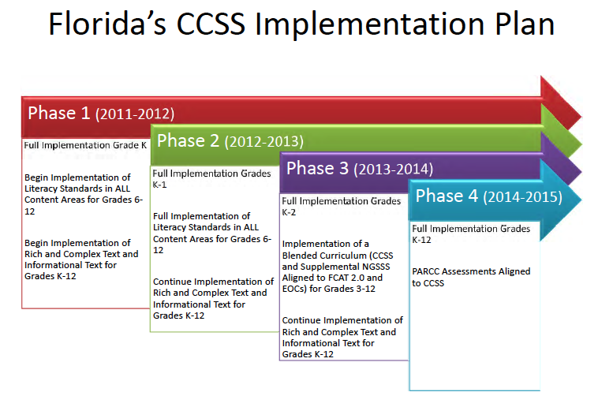

http://www.fldoe.org/bii/pdf/CCSS-ImplementationTimeline.pdf
Notes:
Intro 90 minute session with Shelby

Slide 4
Florida’s Common Core State Standards Implementation Timeline
Year/Grade Level | K | 1 | 2 | 3-8 | 9-12
2011-2012 | FL | L | L | L | L
2012-2013 | F L | F L | L | L | L
2013-2014 CCSS fully implemented | F L | F L | F L | B L | B L
2014-2015 CCSS fully implemented and assessed | F L | F L | F L | F L | F L
F - full implementation of CCSS for all content areas
L – begin full implementation of content area literacy standards including: (1) use of informational text, text complexity, quality and range in all grades (K-12), and (2) CCSS Literacy Standards in History/Social Studies, Science, and Technical Subjects (6-12)
B - blended instruction of CCSS with Next Generation Sunshine State Standards (NGSSS); last year of NGSSS assessed on FCAT 2.0
http://www.fldoe.org/bii/pdf/CCSS-ImplementationTimeline.pdf
Notes:
Presenter Directions
Say: Full implementation of CCSS began with Kindergarten in 2011-12
Say: It is essential that complex, rich, informational text become an integral part of instruction for reading and writing beginning with Kindergarten; informational text should include topics related to History, Social Studies, Science, and Technical Subjects at every grade level.
Say: 2013-14 will be our year of transition for grades 3 through 12. Instruction should be blended (a combination of the CCSS and NGSSS) as appropriate to ensure there are no gaps in presentation of the content.

Slide 5


Slide 6

The standards are informed by the highest, most effective models from states across the country and countries around the world, and provide teachers and parents with a common understanding of what students are expected to learn. Consistent standards will provide appropriate benchmarks for all students, regardless of where they live.

Slide 7
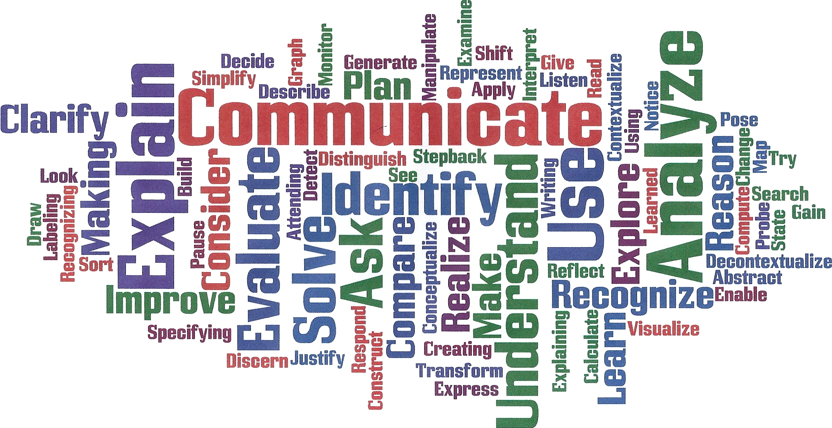
Notes:
Presenter Directions
Say: You have now had a chance to hear about each of these 8 Common Core Standards for Mathematical Practice. As you listened to the various words that were being identified what did you notice about the different words?
Say: These words emphasize the actions, the changes in instruction, teaching and learning. These actions are the major shifts for the Common Core State Standards for Mathematics.

Slide 8

These standards define the knowledge and skills students should have within their K-12 education careers so that they will graduate high school able to succeed in entry-level, credit-bearing academic college courses and in workforce training programs.

Slide 9
Common Core Standards
Are aligned with college and work expectations;
Are clear, understandable and consistent;
Include rigorous content and application of knowledge through high-order skills;
Build upon strengths and lessons of current state standards;
Are informed by other top performing countries, so that all students are prepared to succeed in our global economy and society; and
Are evidence-based.

Slide 10
“Learning is not a spectator sport. Students do not learn just sitting in classes listening to teachers, memorizing prepackaged assignments, and spitting out answers. They have to talk about what they are learning, write reflectively about it, relate it to past experiences, and apply it to their daily lives. They must make what they learn part of themselves.”
~Chickering & Gamson, 1987
Notes:
Say, “Learning involves more than students listening to lectures, memorizing formulas, and placing too much emphasis on getting the right answer. It requires students to talk about what they are learning, reflect upon it, relate it to past experiences, and apply it to their daily lives.”

Slide 11
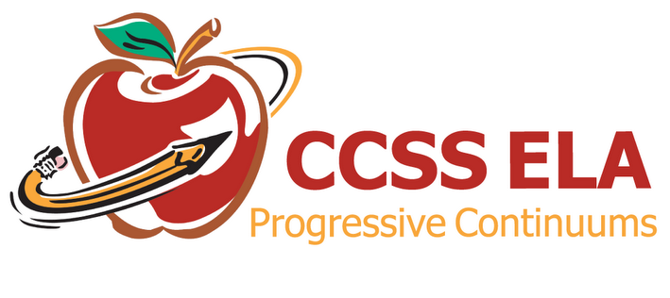
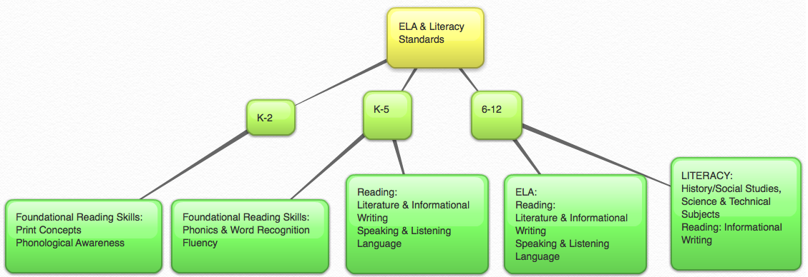

Slide 12
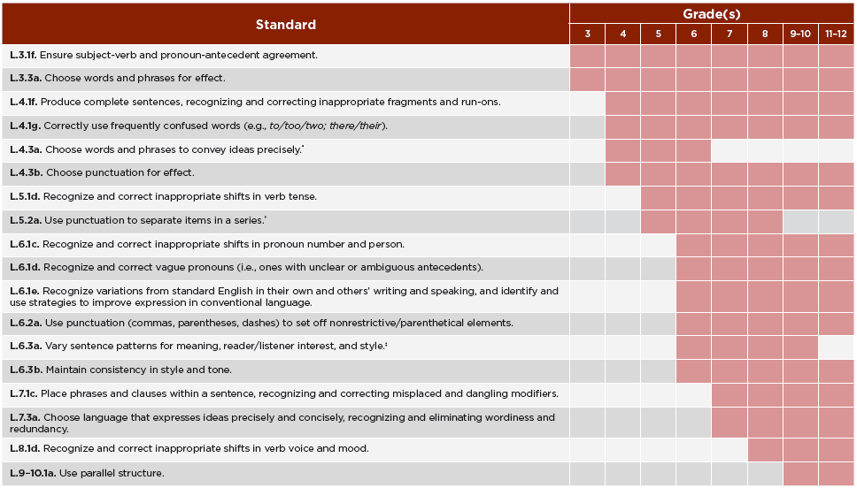
Language Progressive Skills by Grade

Slide 13

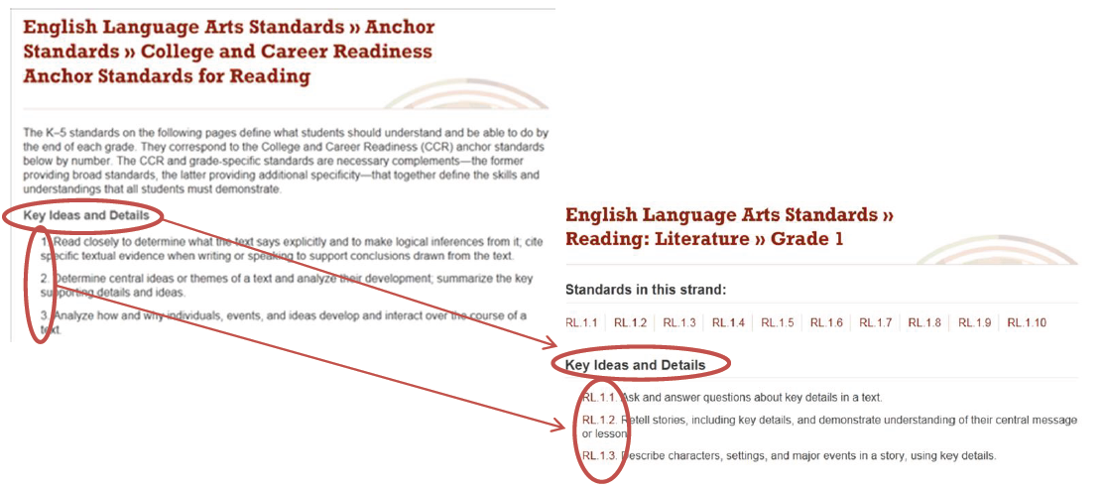
Notes:
Individual CCR anchor standards can be identified by their strand, CCR status, and number (R.CCR.1, in the example above, represents Standard 1 under key ideas and details). Individual grade-specific standards can be identified by their strand, grade, and number (or number and letter, where applicable), so that RL1.1, in the example above, stands for Reading, Literature, grade 1, standard 1.

Slide 14
Florida’s Numbering of the Common Core State Standards
English Language Arts
LACC.1112.WHST.1.1
Subject Grade Strand Cluster Standard
For this example, Language Arts Common Core;
Grades 11-12; Writing in History, Science, and Technical
Subjects; Text Types and Purposes; Standard 1

Slide 15
ELA Standards Advances
The standards devote as much attention on what students read, in terms of complexity, quality, and range, as they do on how students read. As students progress through the grades, they must both develop their comprehension skills and apply them to increasingly complex texts.
The progression of the standards is based on evidence and anchored in the college and career readiness (CCR) standards. The CCR standards define broad competencies and reading, writing, speaking, listening, and language while the K-12 standards lend further specificity by defining a developmentally appropriate progression of skills and understandings.
In order to prepare students for the challenges of college and career texts, the standards require a rich reading of literature as well as extensive reading in science, history/social studies, and other disciplines.
Students are required to learn certain critical content, including classic myths and stories from around the world, America’s Founding Documents, and foundational American literature.
The standards also require that students systematically develop knowledge of literature as well as knowledge in other disciplines through reading, writing, speaking, and listening in history/social studies and science.
Notes:
15

Slide 16
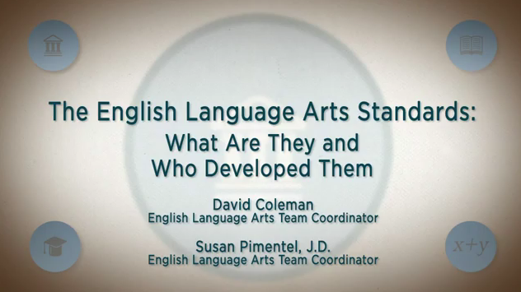

Slide 17
Key Points In
English Language Arts
Reading
The standards establish a “staircase” of increasing complexity in what students must be able to read so that all students are ready for the demands of college- and career-level reading no later than the end of high school. The standards also require the progressive development of reading comprehension so that students advancing through the grades are able to gain more from whatever they read.
Through reading a diverse array of classic and contemporary literature as well as challenging informational texts in a range of subjects, students are expected to build knowledge, gain insights, explore possibilities, and broaden their perspective. Because the standards are building blocks for successful classrooms, but recognize that teachers, school districts and states need to decide on appropriate curriculum, they intentionally do not offer a reading list. Instead, they offer numerous sample texts to help teachers prepare for the school year and allow parents and students to know what to expect at the beginning of the year.
The standards mandate certain critical types of content for all students, including classic myths and stories from around the world, foundational U.S. documents, seminal works of American literature, and the writings of Shakespeare. The standards appropriately defer the many remaining decisions about what and how to teach to states, districts, and schools.

Slide 18
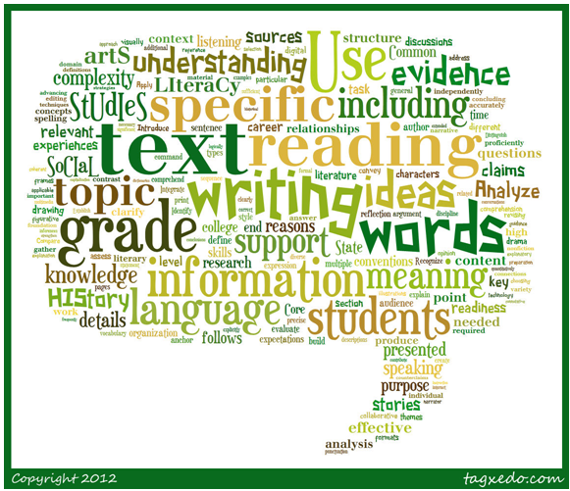
Key Points In
English Language Arts
Writing
The ability to write logical arguments based on substantive claims, sound reasoning, and relevant evidence is a cornerstone of the writing standards, with opinion writing—a basic form of argument—extending down into the earliest grades.
Research—both short, focused projects (such as those commonly required in the workplace) and longer term in depth research —is emphasized throughout the standards but most prominently in the writing strand since a written analysis and presentation of findings is so often critical.
Annotated samples of student writing accompany the standards and help establish adequate performance levels in writing arguments, informational/explanatory texts, and narratives in the various grades.

Slide 19
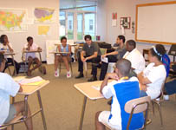
Key Points In
English Language Arts
Speaking and Listening
The standards require that students gain, evaluate, and present increasingly complex information, ideas, and evidence through listening and speaking as well as through media.
An important focus of the speaking and listening standards is academic discussion in one-on-one, small-group, and whole-class settings. Formal presentations are one important way such talk occurs, but so is the more informal discussion that takes place as students collaborate to answer questions, build understanding, and solve problems.

Slide 20

Key Points In
English Language Arts
Language
The standards expect that students will grow their vocabularies through a mix of conversations, direct instruction, and reading. The standards will help students determine word meanings, appreciate the nuances of words, and steadily expand their repertoire of words and phrases.
The standards help prepare students for real life experience at college and in 21st century careers. The standards recognize that students must be able to use formal English in their writing and speaking but that they must also be able to make informed, skillful choices among the many ways to express themselves through language.
Vocabulary and conventions are treated in their own strand not because skills in these areas should be handled in isolation but because their use extends across reading, writing, speaking, and listening.

Slide 21

Key Points In
English Language Arts
Media and Technology
Just as media and technology are integrated in school and life in the twenty-first century, skills related to media use (both critical analysis and production of media) are integrated throughout the standards.

Slide 22
Myths About Content and Quality: English-language arts
Myth: The standards are just vague descriptions of skills; they don't include a reading list or any other similar reference to content.
Fact: The standards do include sample texts that demonstrate the level of text complexity appropriate for the grade level and compatible with the learning demands set out in the standards. The exemplars of high quality texts at each grade level provide a rich set of possibilities and have been very well received. This provides teachers with the flexibility to make their own decisions about what texts to use - while providing an excellent reference point when selecting their texts.

Slide 23
Myths About Content and Quality: English-language arts
Myth: English teachers will be asked to teach science and social studies reading materials.
Fact: With the Common Core ELA Standards, English teachers will still teach their students literature as well as literary non-fiction. However, because college and career readiness overwhelmingly focuses on complex texts outside of literature, these standards also ensure students are being prepared to read, write, and research across the curriculum, including in history and science. These goals can be achieved by ensuring that teachers in other disciplines are also focusing on reading and writing to build knowledge within their subject areas.

Slide 24
Myths About Content and Quality: English-language arts
Myth: The standards don't have enough emphasis on fiction/literature.
Fact: The standards require certain critical content for all students, including: classic myths and stories from around the world, America's Founding Documents, foundational American literature, and Shakespeare. Appropriately, the remaining crucial decisions about what content should be taught are left to state and local determination. In addition to content coverage, the standards require that students systematically acquire knowledge in literature and other disciplines through reading, writing, speaking, and listening.

Slide 25
Myths vs. Facts
Myth: The Standards only include skills and do not address the importance of content knowledge.
Fact: The Standards recognize that both content and skills are important.
In English‐language arts, the Standards require certain critical content for all students, including: classic myths and stories from around the world, America’s Founding Documents, foundational American literature, and Shakespeare. Appropriately, the remaining crucial decisions about what content should be taught are left to state and local determination. In addition to content coverage, the Standards require that students systematically acquire knowledge in literature and other disciplines through reading, writing, speaking, and listening.

Slide 26
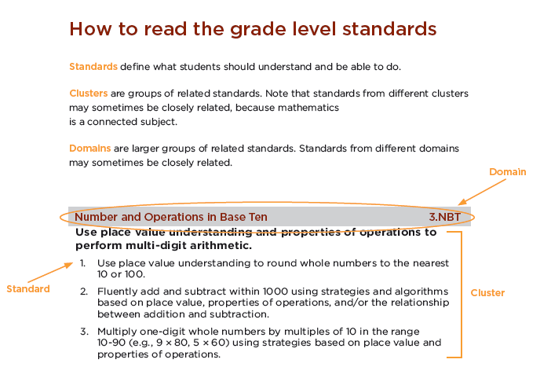

Slide 27
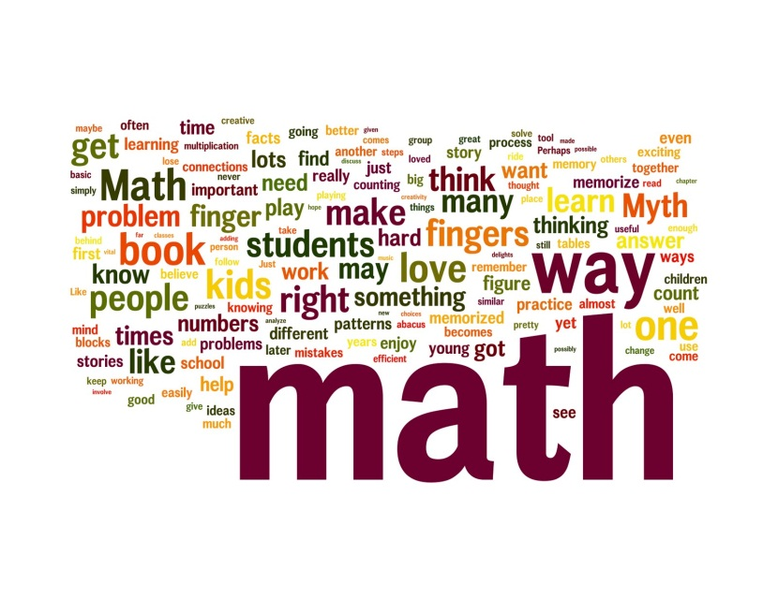
Math Standards Advances
Focus on core conceptual understandings and procedures starting in the early grades. This enables teachers to take the time needed to teach core concepts and procedures well and give students the opportunity to master them.
In grades K-5 students gain a solid foundation in whole numbers, addition, subtraction, multiplication, division, fractions, and decimals. For example, students in Kindergarten focus on the number core (learning how numbers correspond to quantities and learning how to put together and take apart numbers) in order to prepare them for addition and subtraction.
In the middle grades, students build upon the strong foundation in grades K-5 through hands on learning in geometry, algebra, probability, and statistics.
The high school standards call on students to practice applying mathematical ways of thinking to real world issues and challenges and emphasize mathematical modeling.
Notes:
27

Slide 28
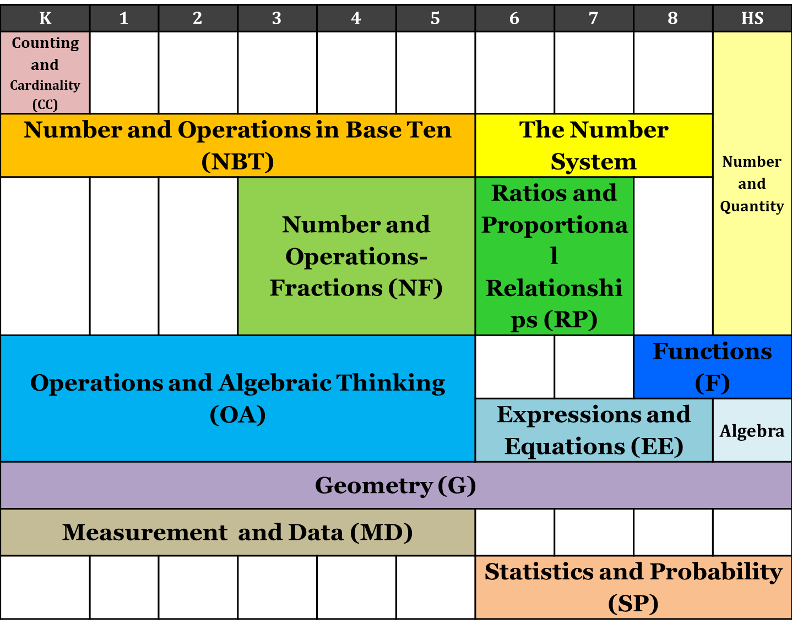
Domains for Math (K-12)

Slide 29
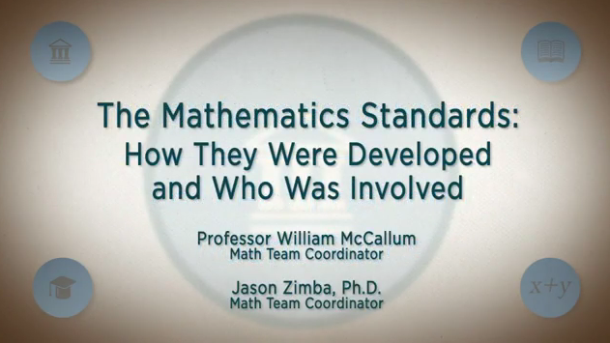

Slide 30
Myths vs. Facts
Myth: The Standards only include skills and do not address the importance of content knowledge.
Fact: The Standards recognize that both content and skills are important.
In Mathematics, the Standards lay a solid foundation in whole numbers, addition, subtraction, multiplication, division, fractions, and decimals. Taken together, these elements support a student’s ability to learn and apply more demanding math concepts and procedures. The middle school and high school standards call on students to practice applying mathematical ways of thinking to real world issues and challenges; they prepare students to think and reason mathematically. The Standards set a rigorous definition of college and career readiness, not by piling topic upon topic, but by demanding that students develop a depth of understanding and ability to apply mathematics to novel situations, as college students and employees regularly do.

Slide 31
Myths About Content and Quality: Math
Myth: The Standards do not prepare or require students to learn Algebra in the 8th grade, as many states’ current standards do.
Fact: The Standards do accommodate and prepare students for Algebra 1 in 8th grade, by including the prerequisites for this course in grades K‐7. Students who master the K‐7 material will be able to take Algebra 1 in 8th grade. At the same time, grade 8 standards are also included; these include rigorous algebra and will transition students effectively into a full Algebra 1 course.

Slide 32
Myths About Content and Quality: Math
Myth: Key math topics are missing or appear in the wrong grade.
Fact: The mathematical progressions presented in the common core are coherent and based on evidence.
Part of the problem with having 50 different sets of state standards is that today, different states cover different topics at different grade levels. Coming to consensus guarantees that from the viewpoint of any given state, topics will move up or down in the grade level sequence. This is unavoidable. What is important to keep in mind is that the progression in the Common Core State Standards is mathematically coherent and leads to college and career readiness at an internationally competitive level.

Slide 33
Connecting the Standards for Mathematical Practice to the Standards forMathematical Content
The Standards for Mathematical Practice describe ways in which developing student practitioners of the discipline of mathematics increasingly ought to engage with the subject matter as they grow in mathematical maturity and expertise throughout the elementary, middle and high school years.

Slide 34
Standards for Mathematical Practice
Make sense of problems and persevere in solving them.
Reason abstractly and quantitatively.
Construct viable arguments and critique the reasoning of others.
Model with mathematics.
Use appropriate tools strategically.
Attend to precision.
Look for and make use of structure.
Look for and express regularity in repeated reasoning.

Slide 35
Standards for Mathematical Practice
Overarching Habits of Mind of a
Productive Mathematical Thinker
1. Make sense of problems and persevere in solving them
6. Attend to precision
Reasoning and Explaining
Modeling
and
Using Tools
Seeing Structure and Generalizing
2. Reason abstractly and quantitatively
3. Construct viable arguments and critique the reasoning of others
4. Model with mathematics
5. Use appropriate tools strategically
7. Look for and make use of structure
8. Look for and express regularity in repeated reasoning
Notes:
Presenter Directions
Say: William McCallum, the coordinator of the Common Core State Standards for Mathematics writing has organized the practice standards in the following way.
Overarching Habits of Mind of a Productive Mathematical Thinker
1. Make sense of problems and persevere in solving them
6. Attend to precision
Reasoning and Explaining
2. Reason abstractly and quantitatively
3. Construct viable arguments and critique the reasoning of others
Modeling and Using Tools
4. Model with mathematics
5. Use appropriate tools strategically
Seeing Structure and Generalizing
7. Look for and make use of structure
8. Look for and express regularity in repeated reasoning
http://www.corestandards.org/the-standards/mathematics/introduction/standards-for-mathematical-practice
Adapted from (McCallum, 2011)

Slide 36

Myths About Implementation
Myth: The Standards tell teachers what to teach.
Fact: The best understanding of what works in the classroom comes from the teachers who are in them. That’s why these standards will establish what students need to learn, but they will not dictate how teachers should teach. Instead, schools and teachers will decide how best to help students reach the standards.

Slide 37
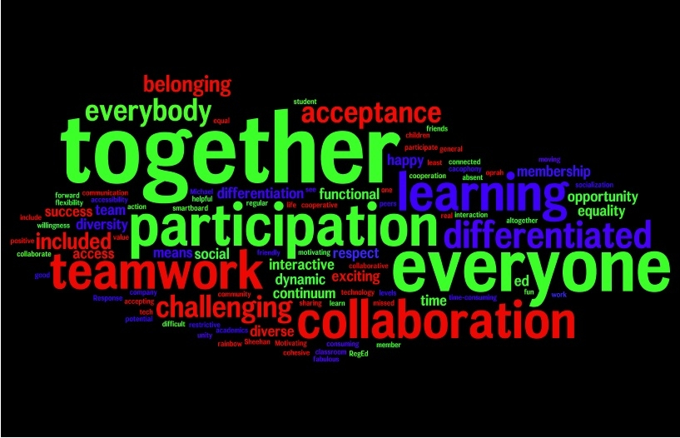
Common Core State Standards Initiative
Standards-SettingConsiderations
Special populations: In the development of these standards, the inclusion of all types of learners was a priority. Writers selected language intended to make the standards documents accessible to different learners.

Slide 38
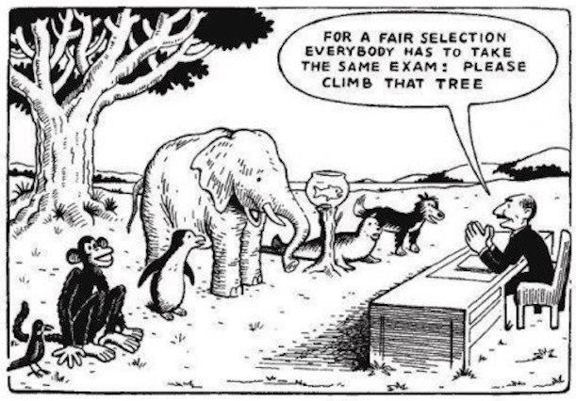
CCSS-Meeting the Needs of ALL Students
The Standards set grade-specific standards but do not define the intervention methods or materials necessary to support students who are well below or well above grade-level expectations.

Slide 39
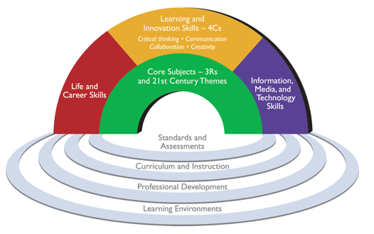
ANCHORED IN COLLEGE AND CAREER READINESS
Every child in America needs to be ready for today’s and tomorrow’s world. A profound gap exists between the knowledge and skills most students learn in school and the knowledge and skills they need for success in their communities and workplaces. To successfully face rigorous higher education coursework, career challenges and a globally competitive workforce, U.S. schools must align classroom environments with
real world environments…
Partnership for 21st Century Skills, 2012, www.p21.org/
Notes:
This clearly states the main purpose for 21st century learning – have participants read and quietly reflect on statement and lend guidance to how CCSS will help build the bridge for this gap…

Slide 40
College and Career Readiness (CCR) for All Students
To help achieve President Obama’s stated goal for the country of ensuring that all students are ready for college and careers when they graduate from high school, the administration has designed a blueprint for a re-envisioned federal role in education through the reauthorization of the Elementary and Secondary Education Act (ESEA). The new ESEA will call for:
Raising standards for all students in English/language arts and mathematics;
Developing better assessments aligned with college- and career-ready standards; and
Implementing a complete education through improved professional development and evidence-based instructional models and supports

Slide 41

Expectations for ALL Students
Students with disabilities ―students eligible under the Individuals with Disabilities Education Act (IDEA)―must be challenged to excel within the general curriculum and be prepared for success in their post-school lives, including college and/or careers.
Promoting a culture of high expectations for all students
is a fundamental goal of the Common Core State Standards.
Notes:
These common standards provide an historic
opportunity to improve access to rigorous academic content standards for students with disabilities. The
continued development of understanding about research-based instructional practices and a focus on their
effective implementation will help improve access to mathematics and English language arts (ELA)
standards for all students, including those with disabilities.

Slide 42
Common Core State Standards Initiative
Standards-Setting Considerations
Standards and curriculum: Standards are not curriculum. This initiative is about developing a set of standards that are common across states. The curriculum that follows will continue to be a local responsibility (or state-led, where appropriate). There are multiple ways to teach these standards, and therefore, there will be multiple approaches that could help students accomplish the goals set out in the standards.

Slide 43
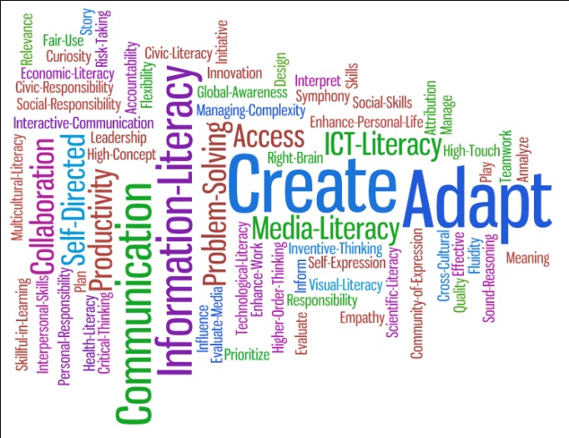
Common Core State Standards Initiative
Standards-Setting Considerations
21st century skills: These documents are not an attempt to demonstrate everything that a student should learn; rather, we have focused on two areas – English-language Arts and Mathematics. The standards have incorporated 21st century skills where possible. They are not inclusive of all the skills students need for success in the 21st Century, but many of these skills will be required across disciplines.

Slide 44

The FRAMEWORK for 21st Century Learning
Notes:
Use this as a resource to how our CCSS are guiding forces for STUDENT LEARNING OUTCOMES (rainbow)
And SUPPORT SYSTEMS (the pool under rainbow)

Slide 45
“We live in a time of vast changes that include accelerating globalization, mounting quantities of information, the dominating influence of science and technology, and the clash of civilizations. Those changes call for new ways of learning and thinking in school, business, and the professions.”
-Howard Gardner
Five Minds for the Future (2007)
Notes:
Facilitator Directions:
Read the slide
“We live in a time of vast changes that include accelerating globalization, mounting quantities of information, the dominating influence of science and technology, and the clash of civilizations. Those changes call for new ways of learning and thinking in school, business, and the professions.”
-Howard Gardner ‘s book Five Minds for the Future (2007)
Click to display the Common Core State Standards graphic.
Say: The Common Core State Standards for Mathematics address the call for new ways of teaching, learning, and thinking!
Say: During the next few days, you will be involved in planning your schools steps for helping teachers embrace the call for new ways of teaching and the implementation of the Common Core State Standards for Mathematics.

Slide 46

Unpacking Standards
“Unwrapped standards provide clarity as to what students must know and be able to do. When teachers take the time to analyze each standard and identify its essential concepts and skills, the result is more effective instructional planning, assessment and student learning.”
Ainsworth, L. (2003). Unwrapping the standards: A simple process to make standards manageable. Englewood, CO: Lead + Learn Press.
Notes:
Presenter Directions
Say: The next part of today’s session is designed to provide you with a working knowledge concerning how to effectively unpack the Common Core State Standards for Mathematics.
Read the quotation by Ainsworth.
Larry Ainsworth (2003) wrote, “Unwrapped standards provide clarity as to what students must know and be able to do. When teachers take the time to analyze each standard and identify its essential concepts and skills, the result is more effective instructional planning, assessment and student learning.”
Ainsworth, L. (2003). Unwrapping the standards: A simple process to make standards manageable. Englewood, CO: Lead + Learn Press.

Slide 47
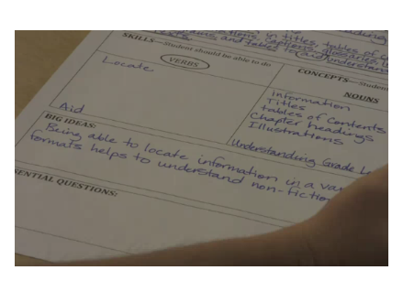
Unpacking Standards
The unpacking process allows teachers and administrators to determine what matters most (i.e. pacing, assessment, critical focus areas)
  Clarity
  Alignment
  Continuity
  Integration
  Baseline
Notes:
Presenter Directions
Say: The unpacking process allows teachers and administrators to determine what matters most (i.e., pacing, assessment, critical focus areas.)
Say: Benefits for Unpacking Standards include:
Greater clarity to all K-12 teachers and administrators
Improved alignment
Improved continuity for students between courses and between grades
Increased opportunities for curriculum integration
Provides educators with a baseline or starting point for lesson planning and differentiated instruction
Provides clarity on which skills and concepts should be taught and assessed.
Have participants locate Handout #7: Unpacking Standards Graphic Organizer.
Say: Let’s take a few minutes to watch a video that demonstrates an unpacking process.
Watch Video: http://youtu.be/sTd7TN1_vsM
http://www.youtube.com/watch?v=sTd7TN1_vsM

Slide 48
Unpacking Common Core Standards
Step 1: Select standard to be unpacked
College and Career Readiness Anchor Standards for Speaking and Listening
Presentation of Knowledge and Skills(Grade 8) #5 (LACC.8.SL.5.5)
  Integrate multimedia and visual displays into presentations to clarify information, strengthen claims and evidence, and add interest.

Slide 49
Unpacking Common Core Standards
Step 2: Circle the verbs and verb phrases (skills)
Integrate multimedia and visual displays into presentations to clarify information, strengthen claims and evidence, and add interest.

Slide 50
Unpacking Common Core Standards
Step 3: Underline the nouns and noun phrases (knowledge)
Integrate multimedia and visual displays into presentations to clarify information, strengthen claims and evidence, and add interest.

Slide 51
Unpacking Common Core Standards
Create Media Products
Understand and utilize the most appropriate media creation tools
Apply Technology Effectively
Use technology as a tool to research, organize, evaluate and communicate information
Manage, integrate, evaluate information
Think Creatively
Use a wide range of idea creation techniques
Elaborate, refine and analyze own ideas to improve creative efforts
Communicate ideas to others effectively
Demonstrate originality in work
Articulate thoughts and ideas effectively
Set goals with success criteria
Utilize time and manage workload efficiently
Monitor, define, prioritize and complete tasks
Go beyond basic mastery of skills
Demonstrate initiative to advance skill levels
Step 4: Identify implied engagement skills/21st Century Skills
Integrate multimedia and visual displays into presentations to clarify information, strengthen claims and evidence, and add interest.

Slide 52
Unpacking Common Core Standards
Step 5: Summarize the instructional implications (knowledge and skills) necessary for mastery of the standards on the activity worksheet
  Integrate multimedia and visual displays into presentations to clarify information, strengthen claims and evidence, and add interest.
Learning Goal(s) and Essential Question Examples (Written in Student Friendly Language)
Students understand and utilize appropriate media creation tools
Students apply technology effectively to integrate multimedia and visual displays into presentations to clarify information.
Students strengthen claims and evidence to multimedia and visual displays.
Student add interest to presentations through multimedia and visual displays.
Students utilize goal setting to monitor progress.
Students elaborate, refine and analyze their own ideas to improve creative efforts throughout presentation utilizing multimedia and visual displays.
Students define, prioritize and monitor their own progress in order to complete tasks to integrate multimedia and visual displays into presentation.
Students effectively articulate thoughts and ideas effectively to strengthen claims and evidence and to add interest throughout presentation.

Slide 53
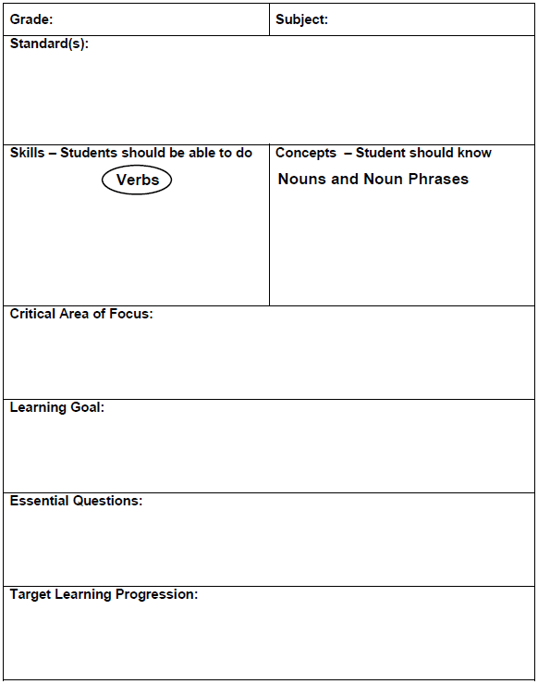

Slide 54
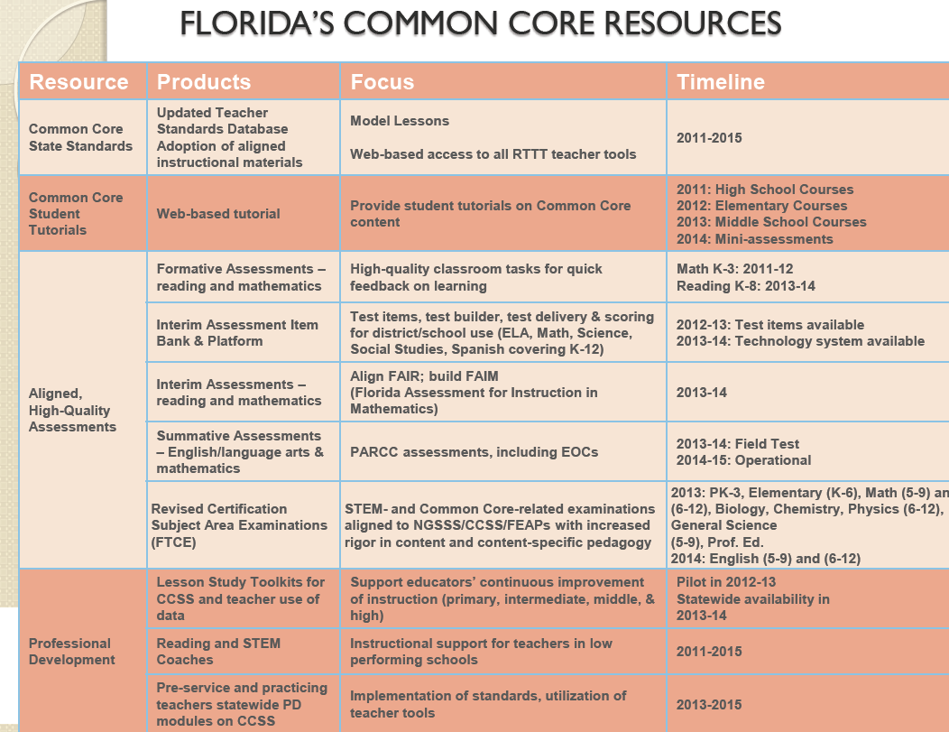

Slide 55



Resources
Notes:
Refer to the Resources page/packet we are providing for participants

Slide 56

Lesson Plan Development
Model Eliciting Activities Development
Variety of Vetted Instructional & Educational Resources
Lesson Study Toolkits & Support System
Peer & Subject Area Expert Reviews and Feedback
Unpacking & Mapping of Standards
Perspectives
CCSS-Cognitive Complexity Ratings

Slide 57

Updates in Literacy
TAP for 2012-2013 Reading Data Report
Updated FCAT 2.0 Reading Test Item Specifications for grades 3-5, 6-8 and 9-10
State Board of Education Update (11/6) on Transition to CCSS and Assessments

Slide 58
Updates in Math
FCR-STEM Conference in December
  St. Petersburg, Hilton (downtown)
Feb, 2012 ($10.5 million) to develop CPALMS
October, 2011 ($495,000 to train middle-school teachers and students in computer-based modeling)
September, 2011 (LSI awarded $2.8 million to improve math in early grades…next slide)

Slide 59

Mathematics Formative Assessment System (MFAS)
Includes 229 math activities, each aligned with current state standards
FCR-STEM will add about 375 activities to the system and align them with the new Common Core State Standards.

Slide 60
Common Core State Standards Initiative
Standards-Setting Considerations

Slide 61
The PARCC Goals
Create high-quality assessments
Build a pathway to college and career readiness for all students
Support educators in the classroom
Develop 21st century, technology-based assessments
Advance accountability at all levels

Slide 62
Goal #1: Create High Quality Assessments
PARCC is developing an assessment system comprised of four components. Each component will be computer-delivered and will leverage technology to incorporate innovations.
  Two summative assessment components designed to
    Make “college- and career-readiness” and “on-track” determinations
    Measure the full range of standards and full performance continuum
    Provide data for accountability uses, including measures of growth
  Two formative assessment components designed to
    Generate timely information for informing instruction, interventions, and professional development during the school year
  In ELA/literacy, a third formative component will assess students’ speaking and listening skills
Notes:
For those that have been following the development of PARCC, the Governing Board did make some refinements to the design based on the input from the PARCC states.
As with PARCC’s initial design, there will be four components to the PARCC system.
PARCC will develop all four components – the first two will be available for all PARCC states and districts to use and administer flexibly.
Summative assessment components will:
Measure the full range of the CCSS and the full range of student performance, including low- and high-performing students
Include achievement levels that signify whether students are “college- and career-ready” by the end of high school and on-track in earlier grades
Produce data that can be used to make a variety of accountability determinations, including measures of student growth
The formative components will be designed to generate timely information during the academic year that can inform instruction, professional development, and supports and interventions for students.
In ELA/literacy, there will be an additional formative component that will assess the speaking and listening standards in the Common Core.
The chief state school officers of the Governing States serve on the PARCC Governing Board and make decisions on behalf of the Partnership on major policies and operational procedures

Slide 63

Timeline
SY 2012-13
First year pilot/field testing and related research and data collection
SY 2013-14
Second year pilot/field testing and related research and data collection
SY 2014-15
Full administration of PARCC assessments
Summer 2015
Set achievement levels, including college-ready performance levels

Slide 64

Contact Information
Rebecca Sarlo, Ph.D.
sarlo@usf.edu
Shelby Robertson, Ph.D.
srobertson@usf.edu
Pam Sudduth, M.A.
psudduth@usf.edu

