Slide 1
School-based
Problem Solving teams
Presented by: Kelly Justice, Regional Coordinator

Slide 2
Advanced Organizer
A little stage setting
The purpose of school-based problem solving teams
The structure of school-based teams
UDL and AT within an MTSS: Implications for school-based teams

Slide 3
For the record…
RtI is the 4th step of the Problem Solving Process
MTSS (aka “RtI”)
Problem solving within an MTSS
MTSS encompasses “Every Ed”

Slide 4
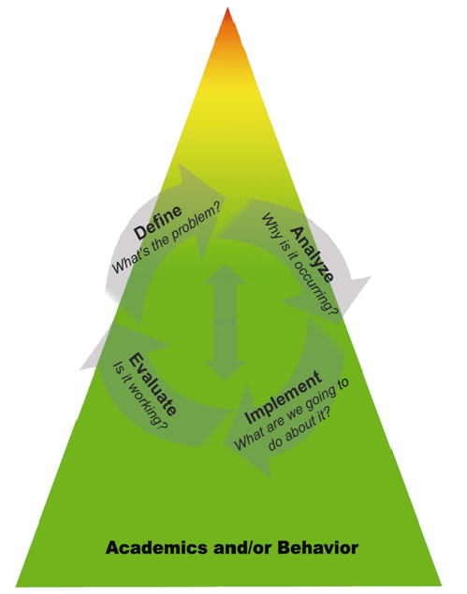
Tiered Model of School Supports & the Problem-Solving Process
ACADEMIC and BEHAVIOR SYSTEMS
Tier 3: Intensive, Individualized, Interventions.
Individual or small group intervention.
Tier 2: Targeted, Strategic Interventions & Supports.
More targeted interventions and supplemental support in addition to the core curriculum and school-wide positive behavior program.
Tier 1: Core, Universal Instruction & Supports.
General instruction and support provided to all students in all settings.
Revised 10.07.09

Slide 5
purpose
School-based Problem Solving Teams

Slide 6
School-based Teams: Attending to the
Essential Components
Multiple tiers of instruction
Use of systematic Problem-Solving (PS) process
Data-based decisions
(Batsche, et. al, 2006)

Slide 7
School-based Teams:
Two-pronged Purpose
Monitor and support student learning
Attend to systemic implementation issues

Slide 8
The literature suggests…
School-based teams:
Include multidisciplinary representation
Plan and facilitate dynamic, school-wide implementation
Communicate/collaborate with the district
Use data to evaluate tiered instruction and ID students in need
Ensure regularly scheduled PS meetings – Tiers 1, 2, 3
Engage in a structured PS process to address student needs
(PS/RtI Evaluation Tool Tech. Assistance Manual, 2012, p. 17)

Slide 9
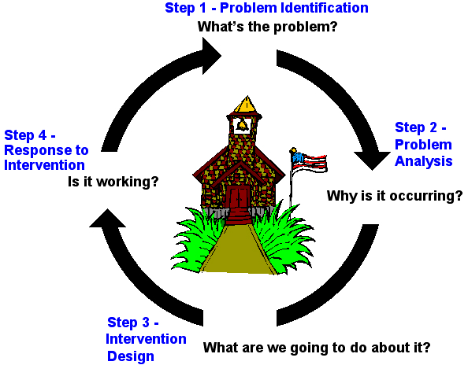
(Florida PS/RtI Project, 2007)
Notes:
A review of the four-step Problem Solving model, to provide context for Step One.

Slide 10
Research indicates…
Teams most effective when they use systematic PS procedures
(Doll et. al., 2005)
Procedural fidelity contributes to positive student outcomes
(Johnson, et. al. 2006)

Slide 11
Structure
School-based Problem Solving Teams

Slide 12
Team Structure
Types
  Standing – Most Effective, Least Efficient
  Ad hoc – Least Effective, Most Efficient
  Core – Same as Ad hoc in Effectiveness, Moderate Efficiency
6 – 8 Members
Gr. level/content area representation
Notes:
Standing team - always the same 6-8 people
Ad hoc - whoever is available
Core - 2-3 consistent members with others fluctuating

Slide 13
Roles & Responsibilities
Membership
Roles
Focus of PS
  Core
  Supplemental
  Individual/intensive
  Implementation/systemic

Slide 14
What are the goals?
Resolution or Improvement of Problem Situation/Attainment of Goal
Improved Problem-Solving/Planning Skills for Person(s) Seeking Assistance and for all Involved in the Process
Notes:
Teams usually create action plans to address one of two needs - either the resolution of a problem or the attainment of a goal.
Functional teams result in continual improvement in problem solving/ planning skills.

Slide 15
Two Sides of Teaming
1. Interpersonal/Group Process
2. Content/Problem Solving
Both are Necessary, but Neither is Sufficient
“An Analysis of Failed Consultation”
Notes:
There is the “feel good” side of the process. Everyone is happy to be there and enjoys the experience.
2. There is the effectiveness of the team. Do problems get solved or goals attained?
A study by Mike Curtis entitled “An analysis of failed consultation” discovered a condition in which all parties felt very positive about the team and its results, but examination of outcomes revealed that nothing changed as a result of the team meetings. So, it’s necessary for folks to view the team experience as valuable, but outcomes have to be measured in order to assure student improvement.

Slide 16
Effective Teams
Human Emphasis
1 9
Task Emphasis
1 9
Notes:
As demonstrated in previous slide, both the human and the task emphases must be addressed.

Slide 17
Human Emphasis
Collaborative Relationship
Active Involvement
Trust/Confidentiality
Voluntary
Non-Judgmental
Decision-Making
Notes:
To be most effective, team members must feel valued in the team process.

Slide 18
Task Emphasis
Importance of roles
  Facilitator
  Timekeeper
  Recorder
Team members prepared
Adherence to team norms

Slide 19
Task Emphasis:
Role of the Facilitator
Ensures pre-meeting preparation
Reviews steps in process and desired outcomes
Facilitates movement through steps
Facilitates consensus building
Sets follow-up schedule/communication
Ensures parent involvement

Slide 20
Step 0
“Step 0” in problem-solving model = building foundation for collaboration.
Steps:
  Establish and maintain rapport among members.
  Formulate sense of trust and respect
  Clarify expectations for participation including roles and responsibilities, shared accountability, legal and ethical guidelines, preferred communication lines and so forth.
  Establish understanding for problem-solving process.

Slide 21
MTSS,UDL & AT
Implications for School-based Teams

Slide 22
“Ecological RtI Model”
Tier 3
Tier 2
Tier 1
More individualized & intensive
Intensive intervention
Includes AT and UDL
Scientifically-based instructional strategies, UDL, technology to support student need
Supplemental intervention
Includes UDL and AT
Core instructional practices
Includes UDL
More proactive and group focused
Based on Basham et. al., 2010

Slide 23
“Ecological RtI Model” Basham et. al., 2010
 | MTSS | UDL
Tiered instruction | Tiered instruction within an integrated system | Proactive environmental and instructional design; intensified tech. solutions + UDL
Data-based problem solving | PS within tiers “a hallmark” | Emphasizes formative environmental data for decision-making
Scientifically-based instruction | Legal requirement; proven effective across multiple fields of practice; need to monitor fidelity; goal: enhance learning for all students
Assessment | Core component | More research needed re: measuring instructional design framework
Family involvement | Increases with intensity; best practice and compliant with legal requirements

Slide 24
UDL and AT within an MTSS
Tier 1
Focus on prevention
Scientifically based C&I
Differentiation: common goals; flexible learning process
(e.g., time, materials, groups)
Systemic supports for implementation
(e.g., collaborative teams, PD, common planning, coaching)
Ex.) Core reading instruction with use of digital text for multiple options for accessibility
Basham et. al., 2010

Slide 25
UDL and AT within an MTSS
Tier 2
Focus on targeted instruction to increase skill/knowledge
Includes targeted use of technologies (more explicit, additional)
Supplement, not supplant
AT more primary role – more individualized technology supports
Ex.) Core instruction & differentiation + explicit small group reading comprehension instruction with text-to- speech software
Basham et. al., 2010

Slide 26
UDL and AT within an MTSS
Tier 3
Focus on identifying instruction/technology/support that will accelerate progress
Individualized/intensive
All staff collaborate to support all students
AT more primary role – more intensive/individualized, possibly more complex
Ex.) Core instruction & differentiation + software system with individualized vocabulary supports, text-to-speech and comprehension supports
Basham et. al., 2010

Slide 27
Implications for School-based Teams
Increased collaboration
Consensus
Infrastructure
Assessment
  Examining instructional design framework
  Ensuring screening and assessment incorporate UDL principles (options for accessibility?)
Intervention design
Process and procedures

Slide 28

Notes:
Time – lapse photography. Ants (teaming) building an ant farm over a 2 week period!

