Slide 1


Slide 2
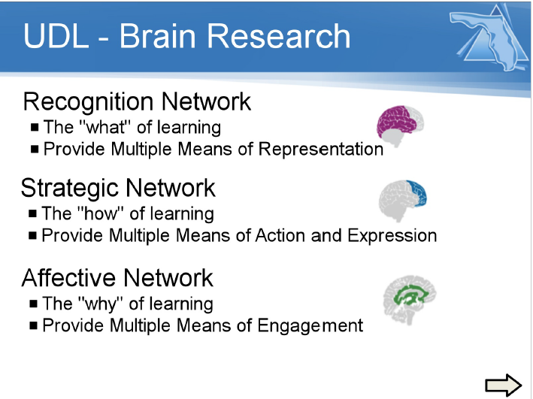

Slide 3



UDL Brain Research
Recognition Network
  The “what” of learning
  Provide Multiple Means of Representation
Strategic Network
  The “how” of learning
  Provide Multiple Means of Action and Expression
Affective Network
  The “why” of learning
  Provide Multiple Means of Engagement
Notes:
Mention CAST.org

Slide 4
Recognition Network
Provide Multiple Means of Representation
  How we gather facts and categorize what we see, hear, and read.
  Identifying letters, words, or an author's style are recognition tasks.

Slide 5
Multiple Means of Representation
Provide options for perception
Provide options for language, mathematical expressions, and symbols
Provide options for comprehension

Slide 6
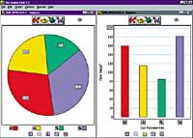
Multiple Means of Representation
Provide options for perception
  Offer ways of customizing the display of information
    Size of text, images, graphs, tables, or other visual content
  Offer alternatives for auditory information
    Captions or automated speech-to-text
  Offer alternatives for visual information
    Provide descriptions (text or spoken) for all images, graphics, videos, or animations

Slide 7
Multiple Means of Representation
Provide options for language, mathematical expressions, and symbols
  Clarify vocabulary and symbols
  Clarify syntax and structure
  Support decoding text, mathematical notation, and symbols
  Promote understanding across languages
  Illustrate through multiple media

Slide 8
Multiple Means of Representation
Provide options for comprehension
  Activate or supply background knowledge
  Highlight patterns, critical features, big ideas, and relationships
  Guide information processing, visualization, and manipulation
  Maximize transfer and generalization

Slide 9
Strategic Network
Provide Multiple Means of Action and Expression
  Planning and performing tasks.
  How we organize and express our ideas.
  Writing an essay or solving a math problem are strategic tasks.

Slide 10
Provide Multiple Means of Action and Expression
Provide options for physical action
Provide options for expression and communication
Provide options for executive functions

Slide 11
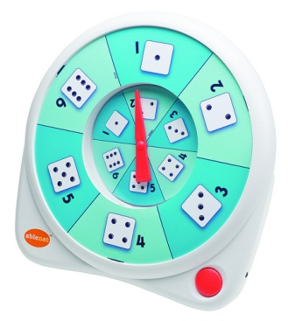
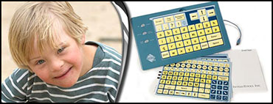
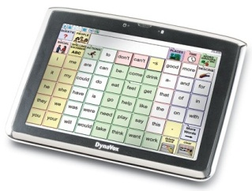
Provide Multiple Means of Action and Expression
Provide options for physical action
  Vary the methods for response and navigation
  Optimize access to tools and assistive technologies

Slide 12
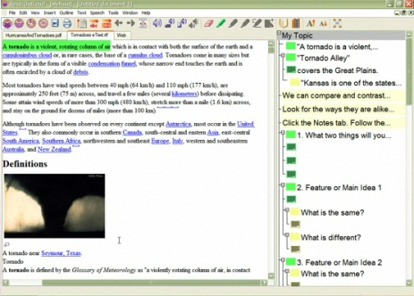
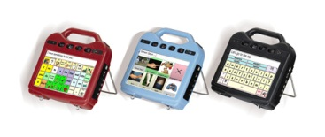
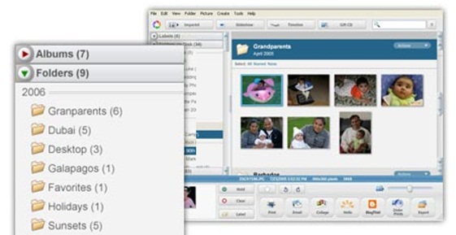
Provide Multiple Means of Action and Expression
Provide options for expression and communication
  Use multiple media for communication
  Use multiple tools for construction and composition
  Build fluencies with graduated levels of support for practice and performance

Slide 13
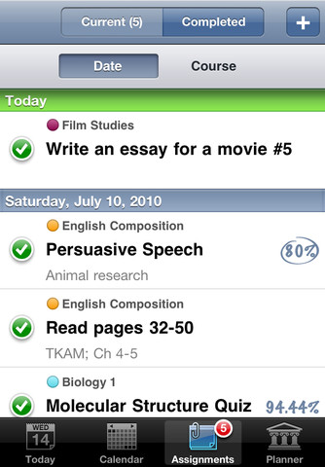
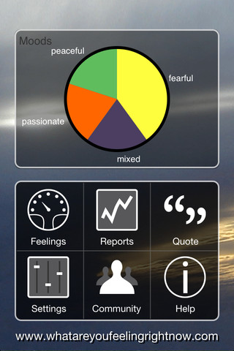
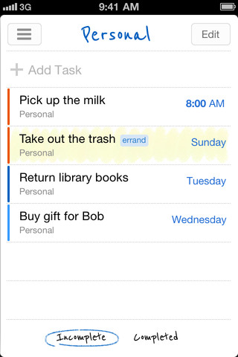
Provide Multiple Means of Action and Expression
Provide options for executive functions
  Guide appropriate goal-setting
  Support planning and strategy development
  Facilitate managing information and resources
  Enhance capacity for monitoring progress

Slide 14
Affective Network
Provide Multiple Means of Engagement
  How learners get engaged and stay motivated.
  How they are challenged, excited, or interested.
  These are affective dimensions.

Slide 15
Provide Multiple Means of Engagement
Provide options recruiting interest
Provide options for sustaining effort and persistence
Provide options for self regulation

Slide 16




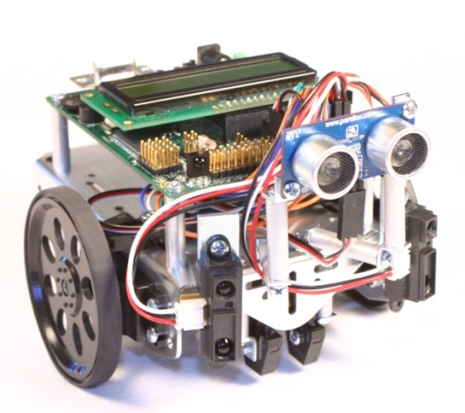

Provide Multiple Means of Engagement
Provide options for recruiting interest
  Optimize individual choice and autonomy
  Optimize relevance, value, and authenticity
  Minimize threats and distractions

Slide 17
Provide Multiple Means of Engagement
Provide options for sustaining effort and persistence
  Heighten salience of goals and objectives
  Vary demands and resources to optimize challenge
  Foster collaboration and communication
  Increase mastery-oriented feedback

Slide 18
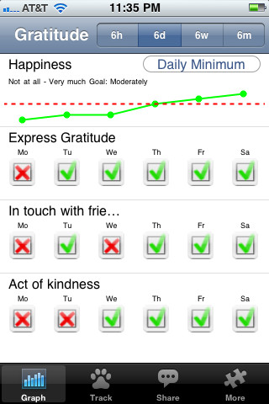
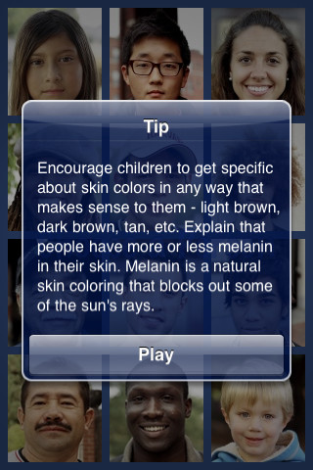
Provide Multiple Means of Engagement
Provide options for self-regulation
  Promote expectations and beliefs that optimize motivation
  Facilitate personal coping skills and strategies
  Develop self-assessment and reflection
Notes:
Before showing nex

Slide 19
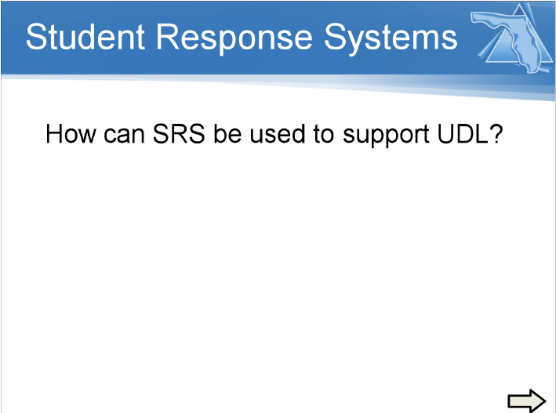

Slide 20
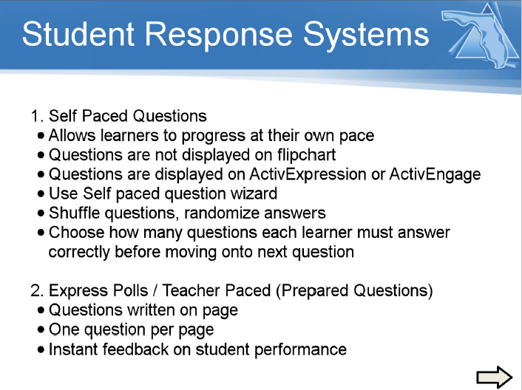

Slide 21


Slide 22
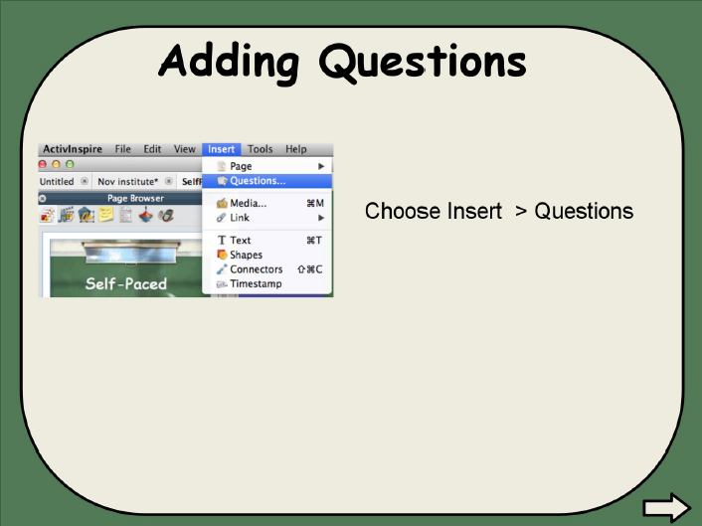

Slide 23
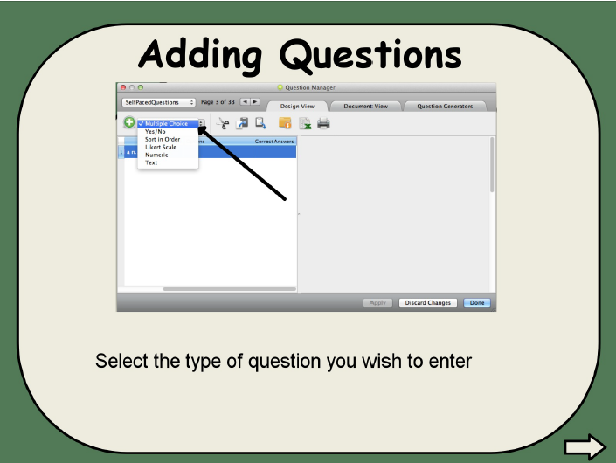

Slide 24
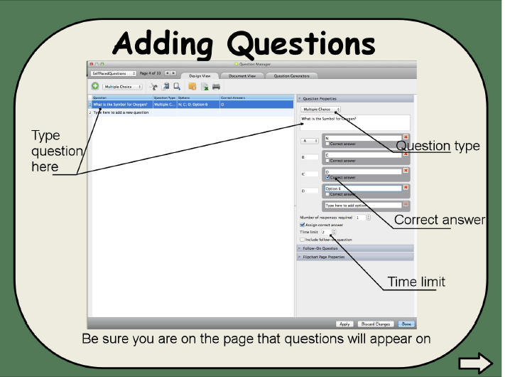

Slide 25
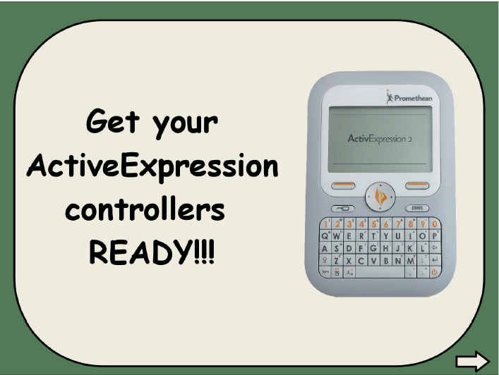

Slide 26
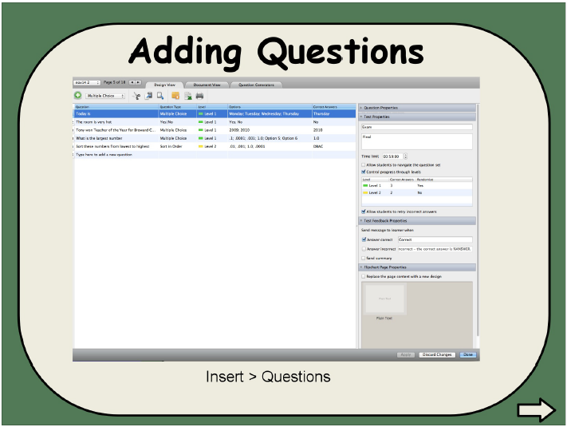

Slide 27
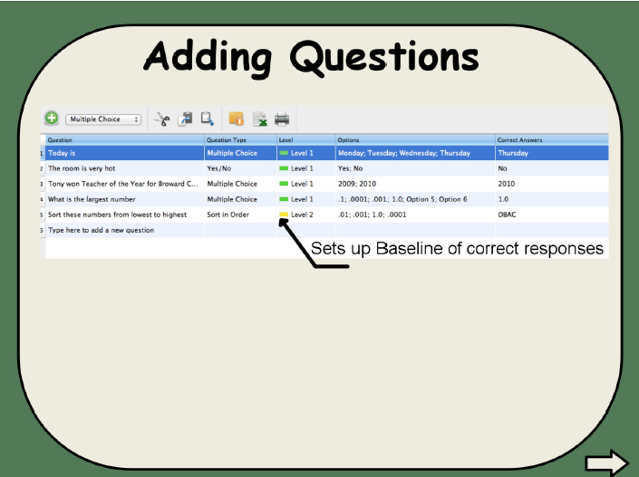

Slide 28
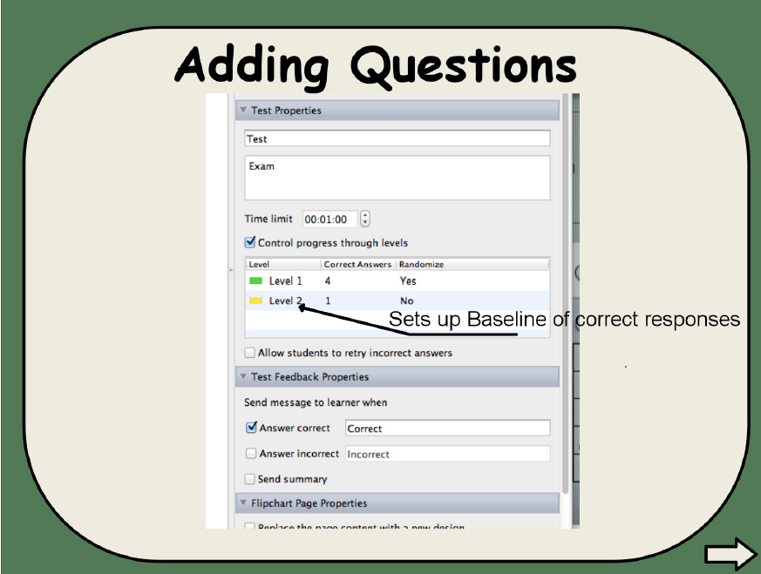

Slide 29
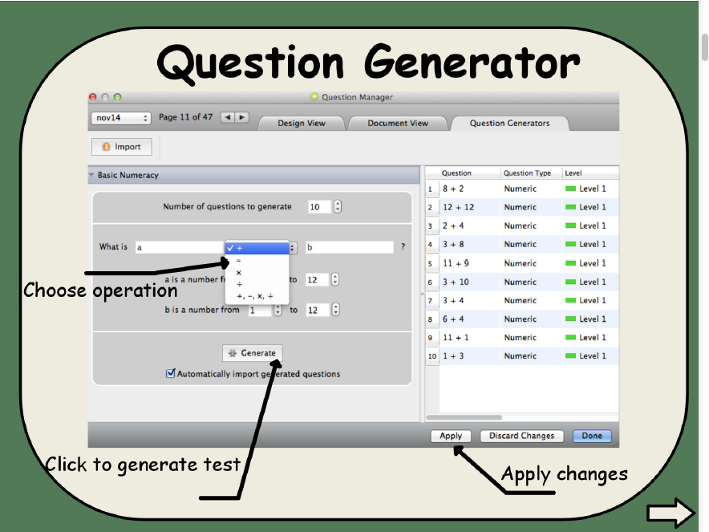

Slide 30
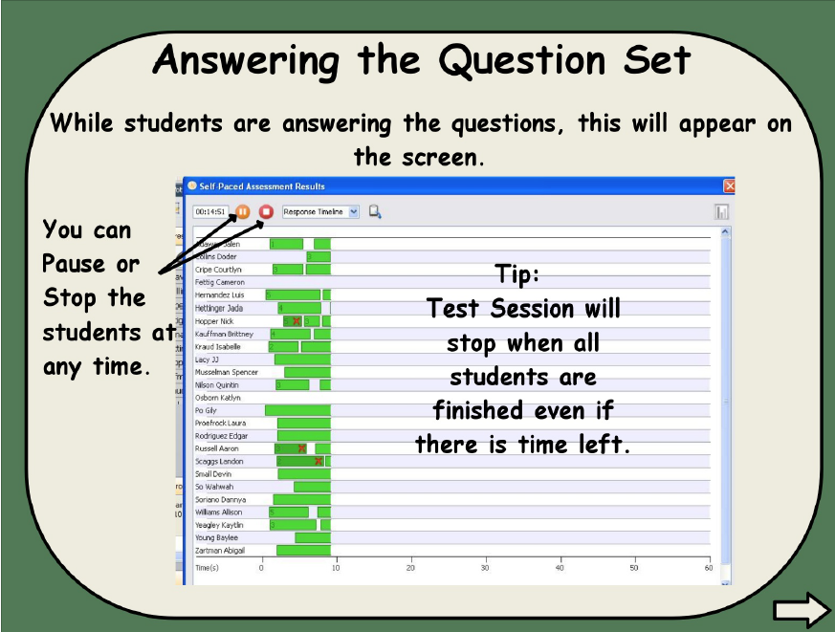

Slide 31
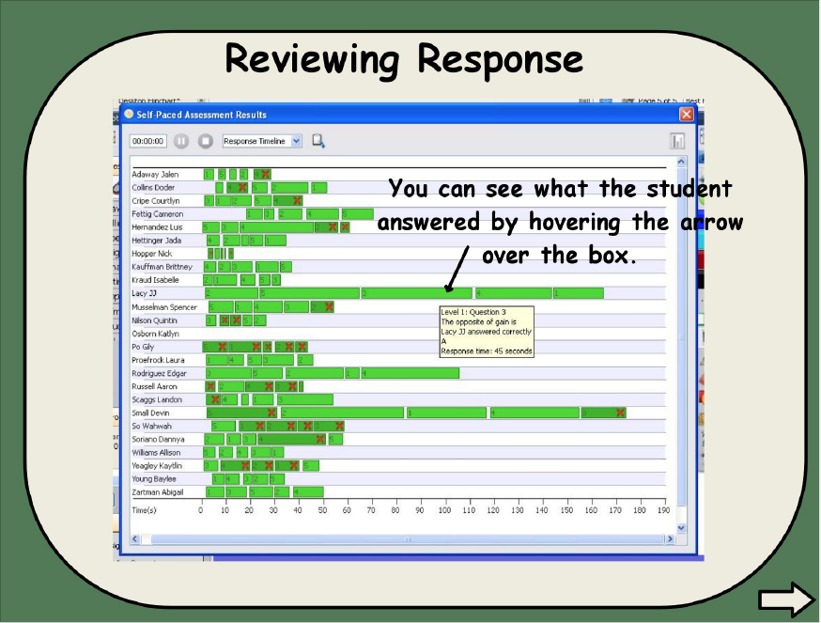

Slide 32
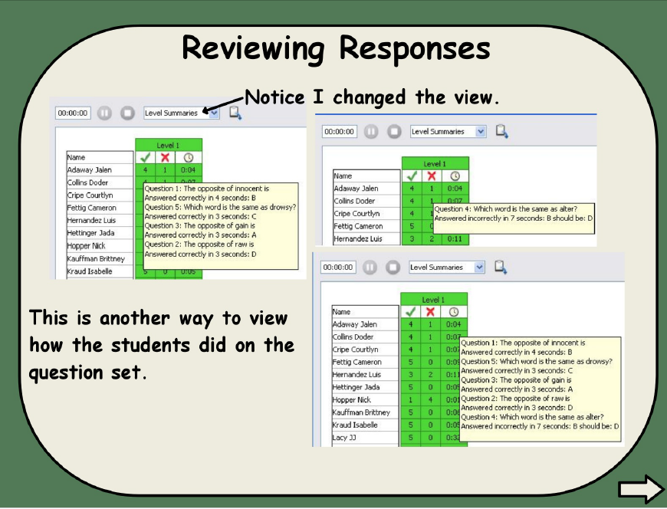

Slide 33
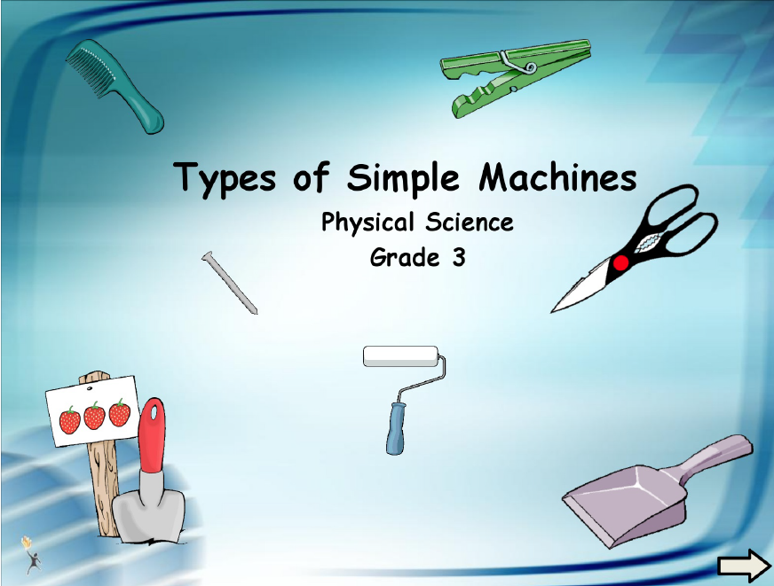

Slide 34
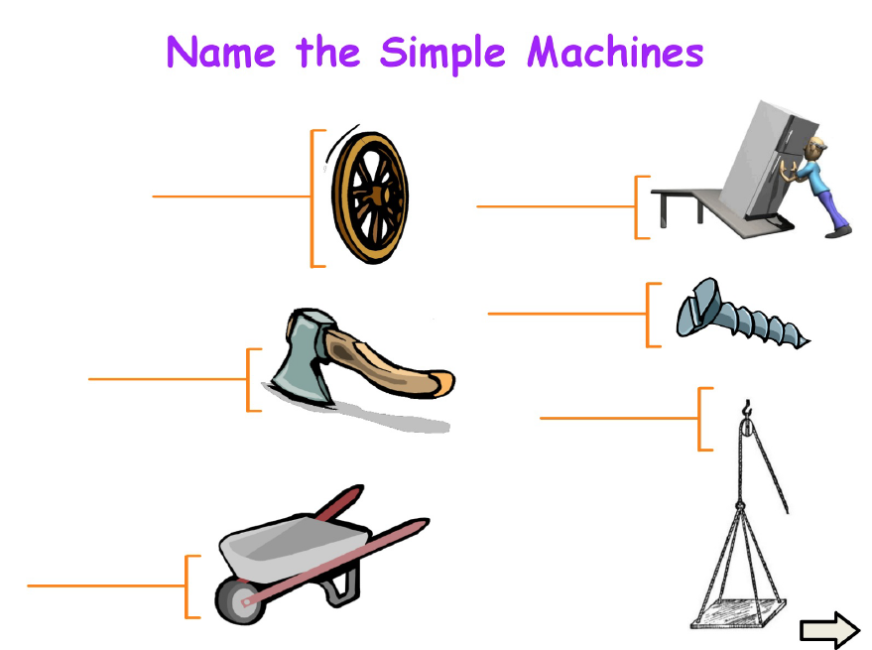

Slide 35
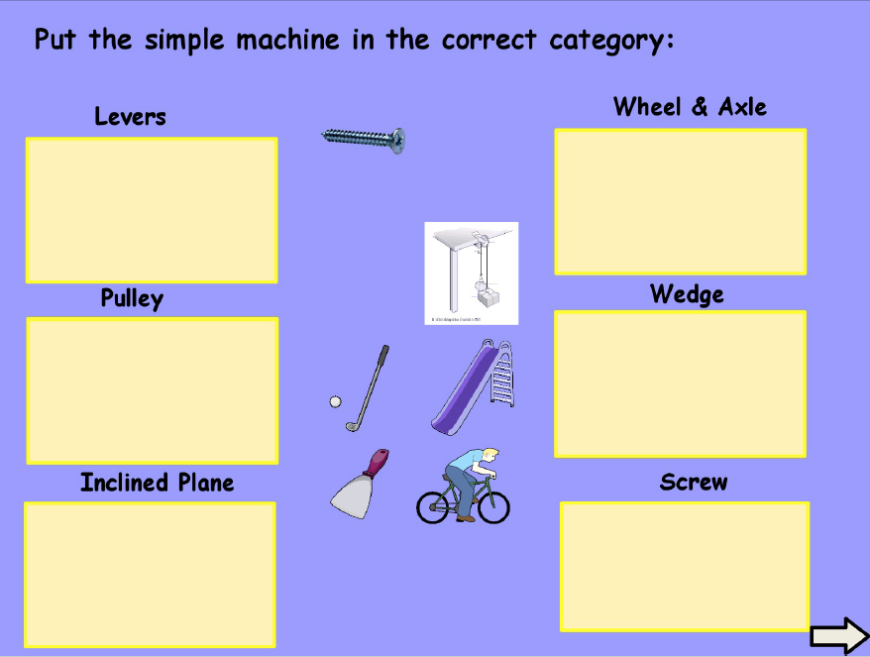

Slide 36
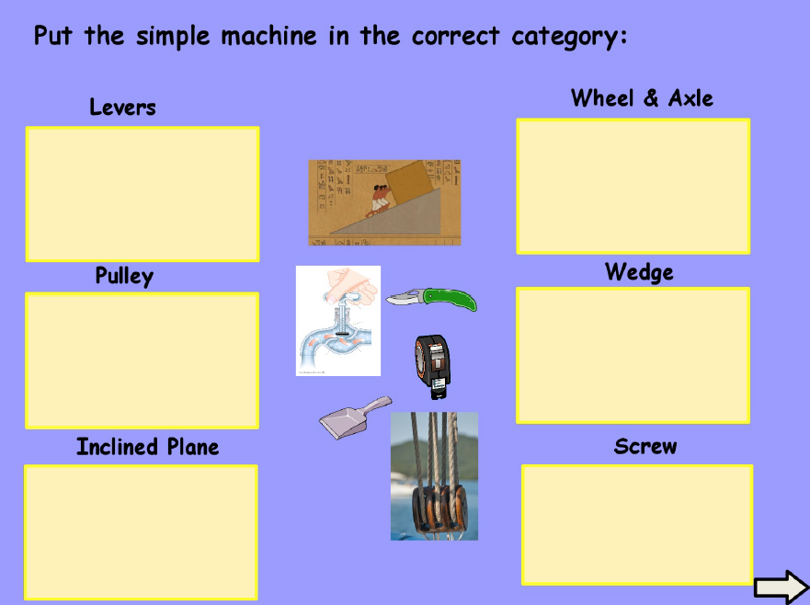

Slide 37
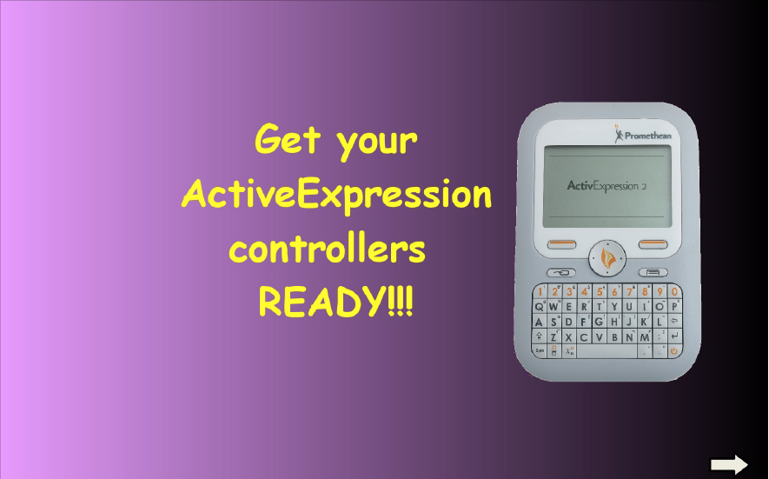

Slide 38


Slide 39
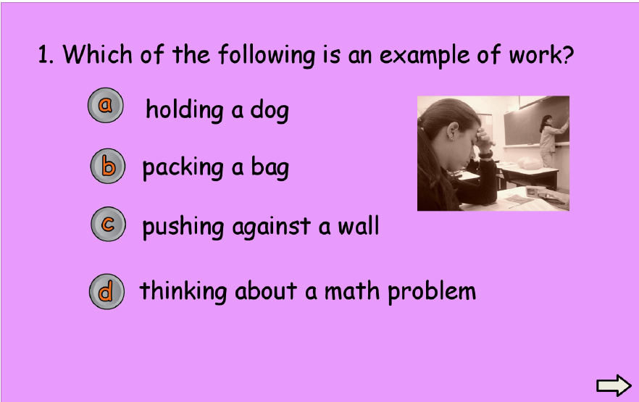

Slide 40
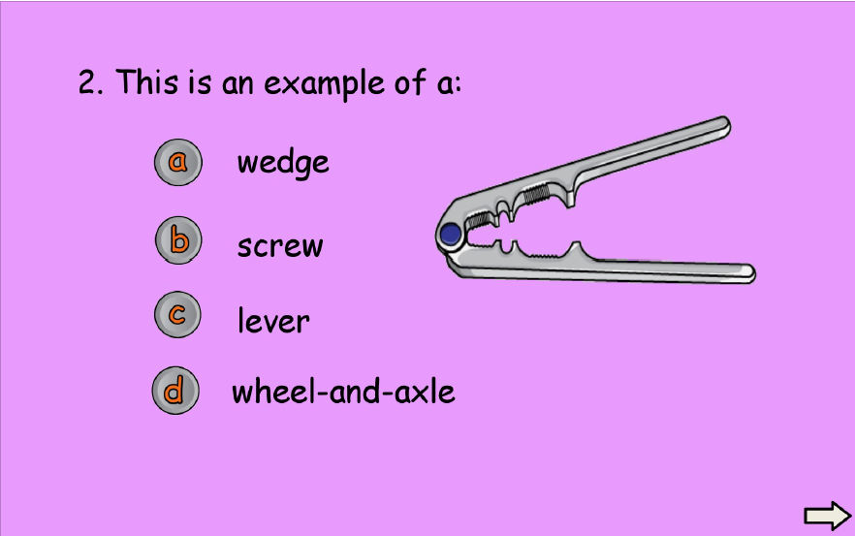

Slide 41
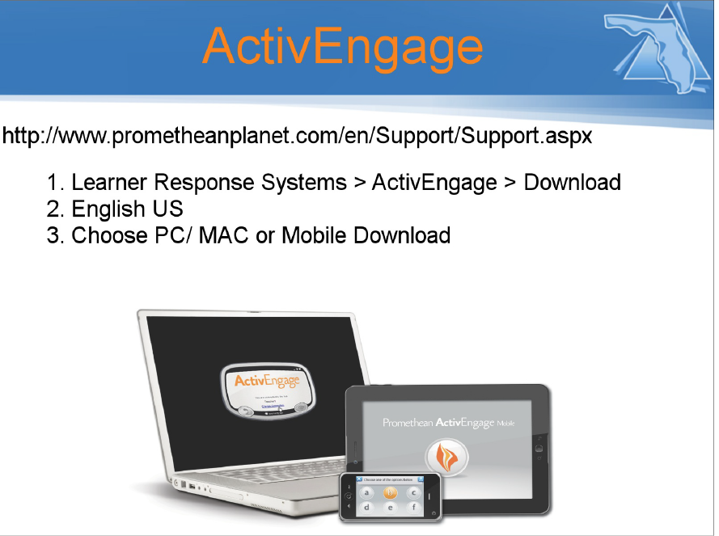

Slide 42


Slide 43
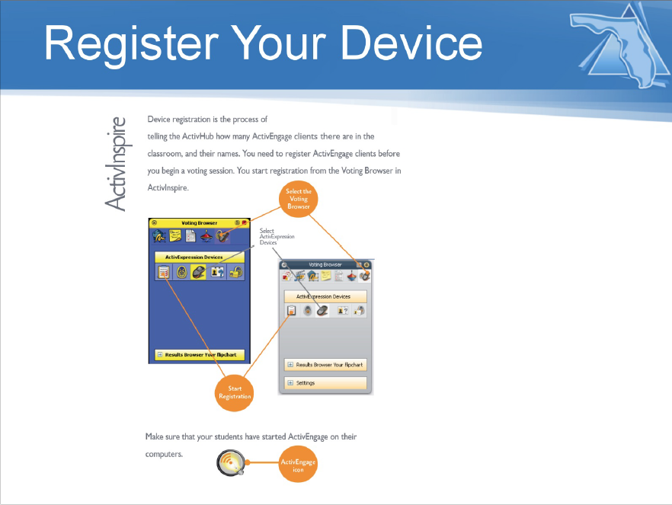

Slide 44
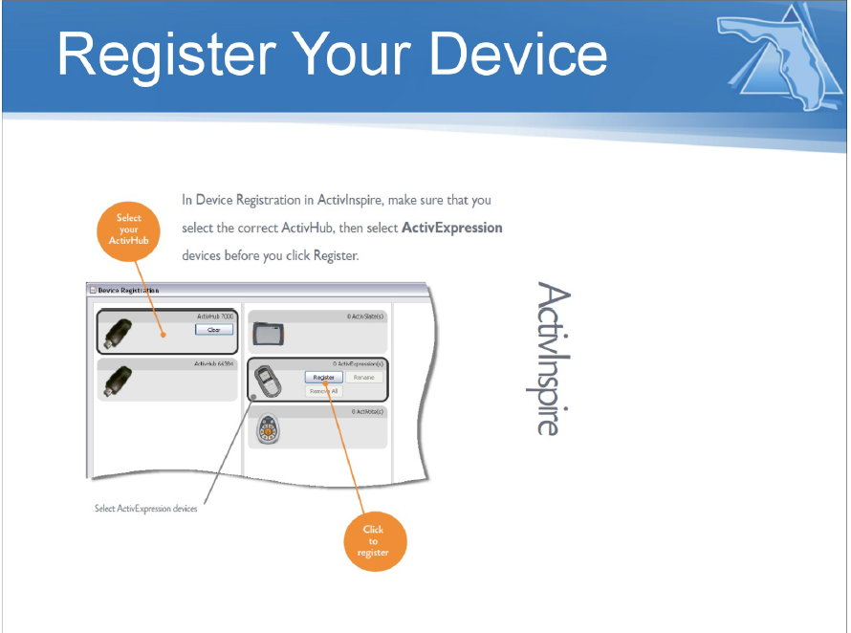

Slide 45
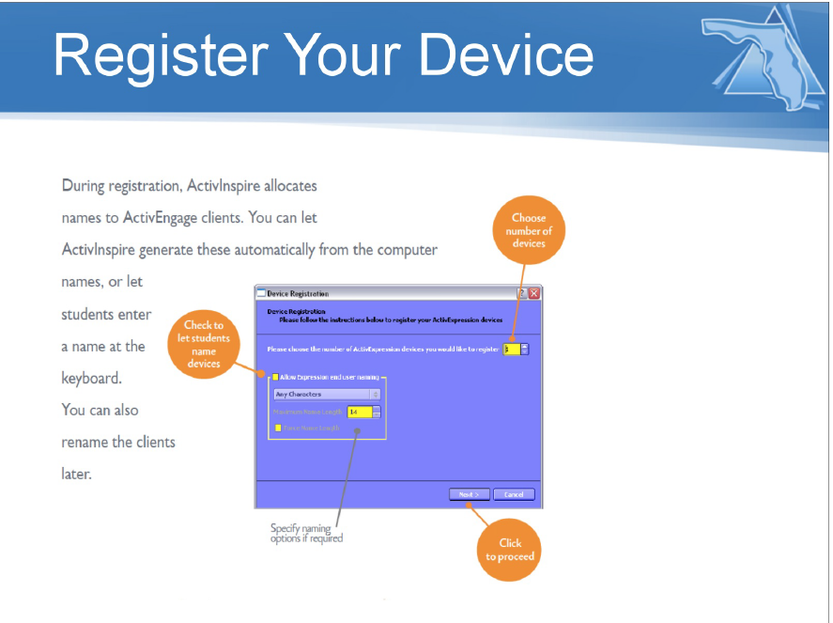

Slide 46
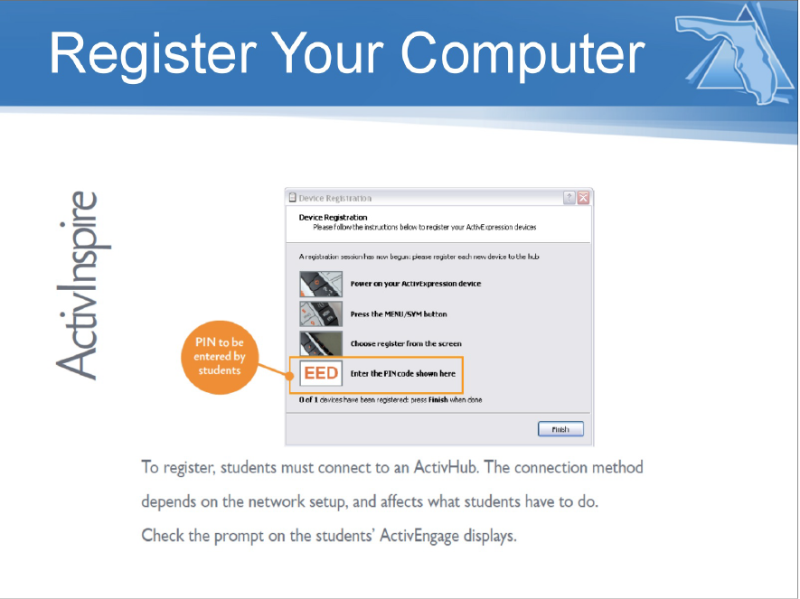

Slide 47


Slide 48
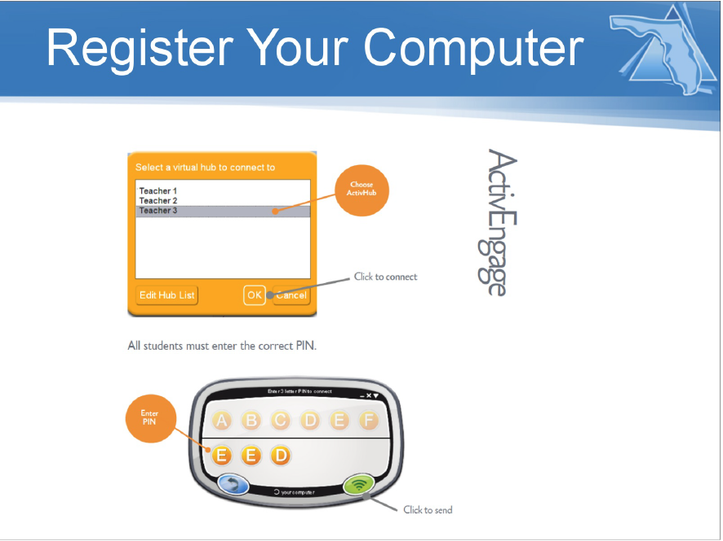

Slide 49


Slide 50
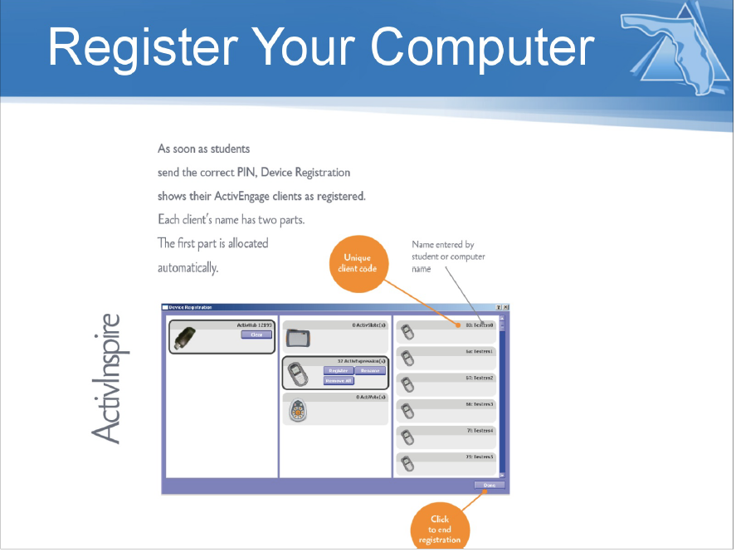

Slide 51
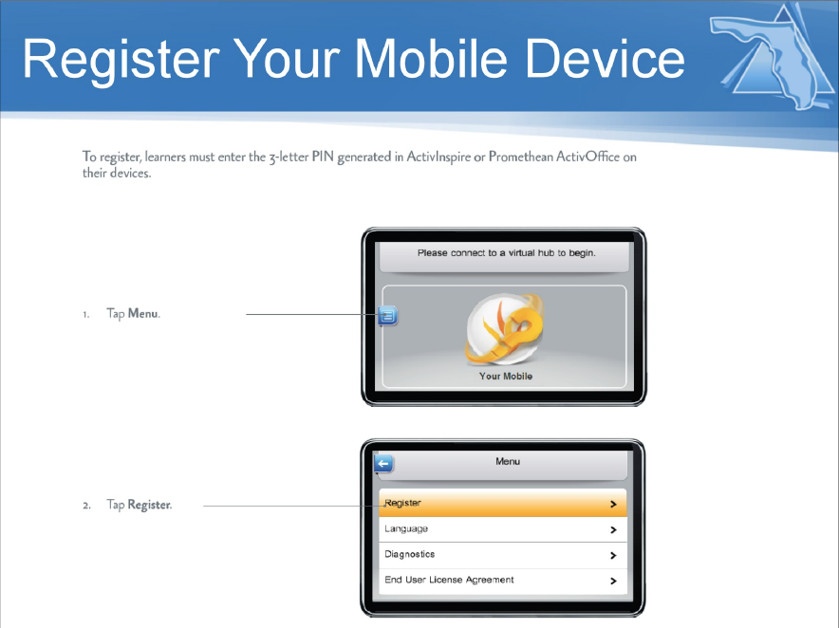

Slide 52
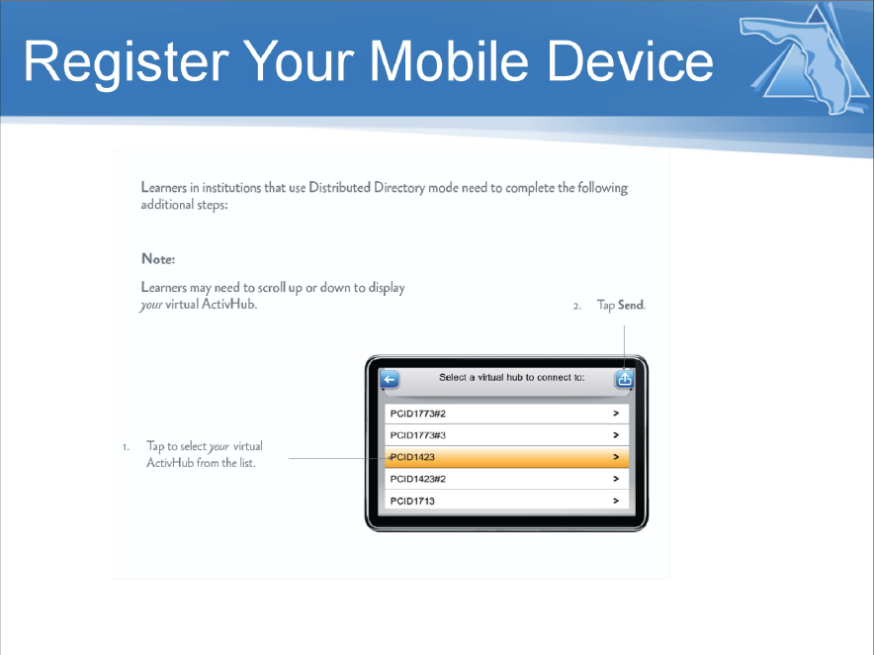

Slide 53
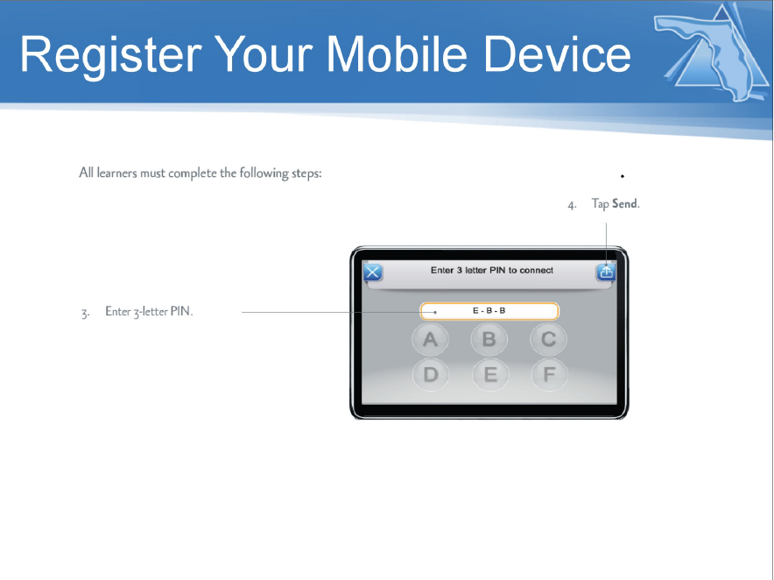

Slide 54
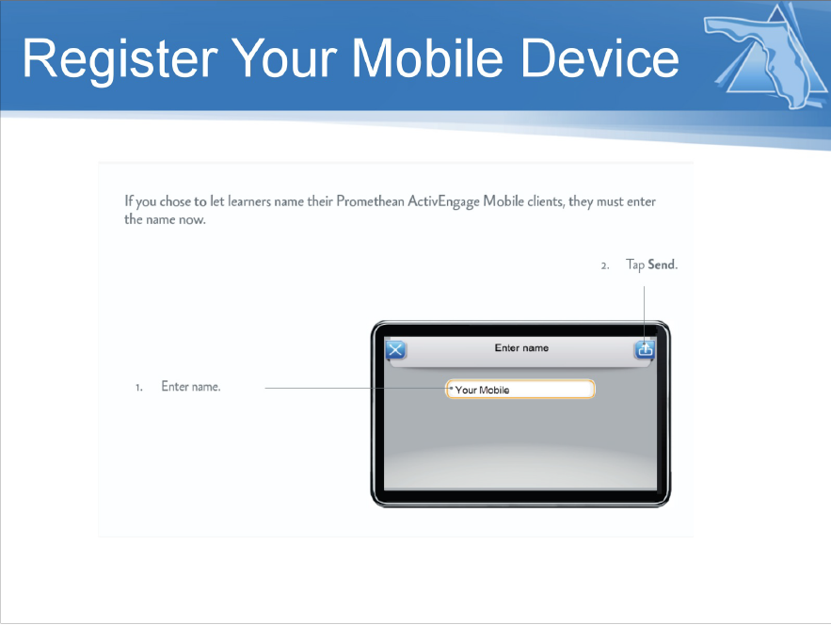

Slide 55
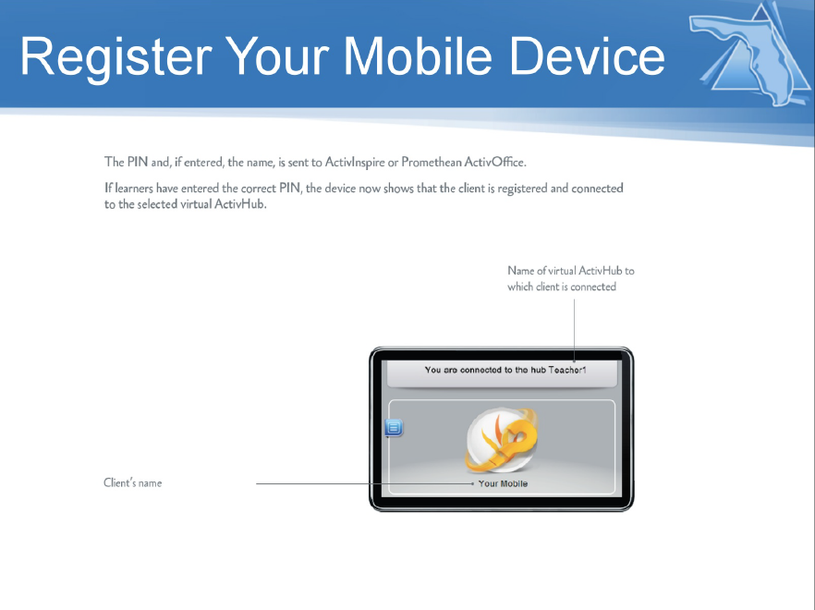

Slide 56


Slide 57
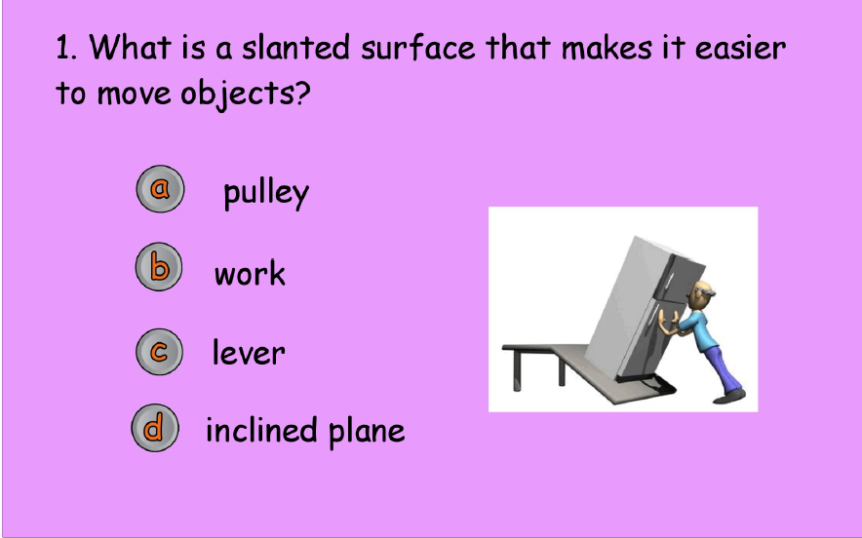

Slide 58
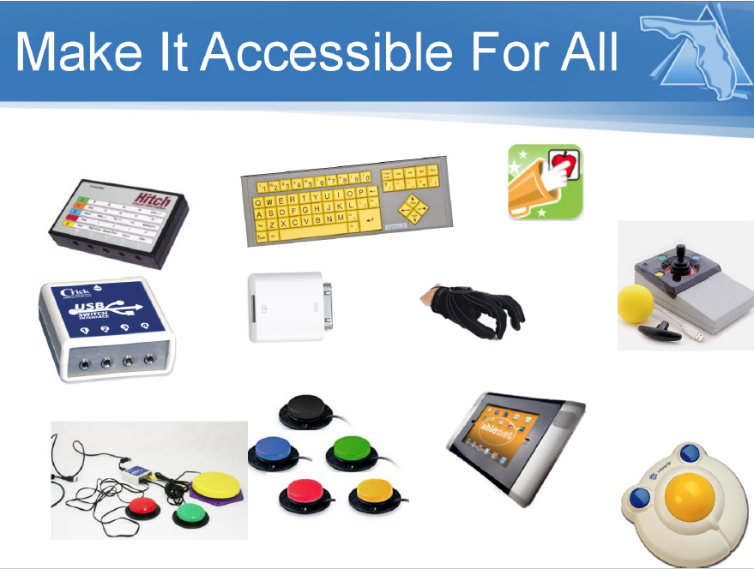

Slide 59
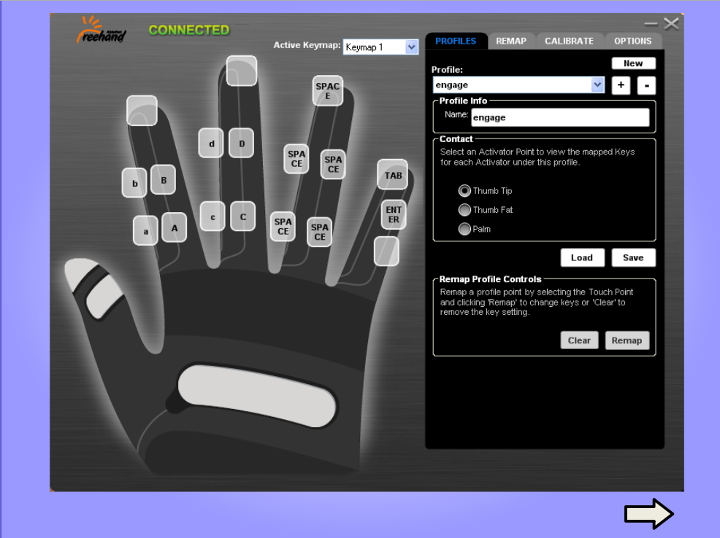

Slide 60


Slide 61
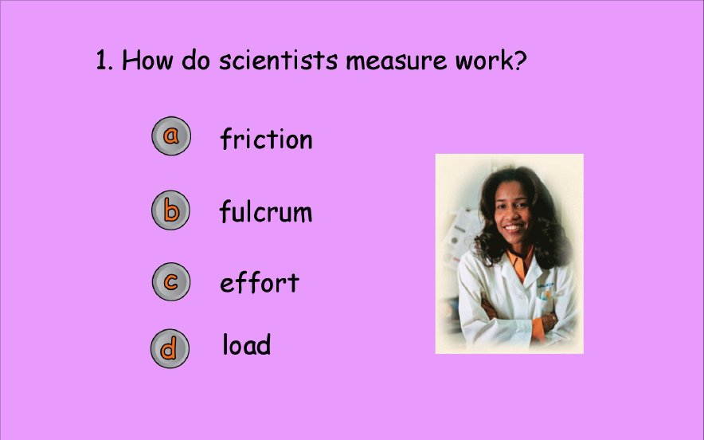

Slide 62


Slide 63


Slide 64


