Slide 1
2012 Annual Statewide Assessment and Accountability Meeting
Accommodations

Slide 2
State Board of Education
Rule 6A-1.0943
Statewide Assessment for Students with Disabilities
Each school board shall utilize appropriate and allowable accommodations for statewide assessments within the limits prescribed herein and current statewide assessment test administration manuals published by the Florida Department of Education Bureau of Assessment and School Performance, and Bureau of Exceptional Education and Student Services.

Slide 3
Available PBT Accommodations for
Students with Disabilities
Accommodation Category | Accommodated Test Materials/Forms
Flexible Presentation | Large Print Braille One-Item-Per-Page
Additional Administration Accommodations: Flexible Responding, Flexible Setting, Flexible Scheduling, Assistive Devices and Tools

Slide 4
Special Document
Configuration
Large Print Kit
  Large Print + Regular Print
Braille Kit
  Braille + Regular Print
  All braille tests: Session/Volume 1 and Session/Volume 2
One-Item-Per-Page Kit
  OIPP + Regular Print

Slide 5
Available CBT Accommodations for
Students with Disabilities
Accommodation Category | Accommodated Test Materials/Forms
Flexible Presentation | TestHear Accommodated CBT Forms Large Print Color Contrast Zoom Screen Reader Paper-Based Accommodations Regular Print Braille Reading Passage Booklets
Assistive Devices and Tools | TestHear Accommodated CBT Form - Assistive Devices
Additional Administration Accommodations: Flexible Responding, Flexible Setting, Flexible Scheduling

Slide 6
TestHear Updates
New software (Version 2.1.0.7) must be downloaded
No four-function or scientific calculator tool
Students using TestHear accommodated forms must be provided the appropriate handheld calculator

Slide 7
Breaking News
Paper-based large print available as a unique accommodation for CBT assessments beginning in Spring 2013
Requirement for large print must be documented, AND the student must be unable to access the computer-based forms
Not a matter of preference

Slide 8
Unique Accommodations Requests
Same process as previous years
Must submit Request Form and documentation (IEP, Section 504 plan, etc.) to determine eligibility
Fall 2012 Unique Accommodations Request Form
  Include requests for Fall Retake only (no OIPP)
2012-2013 Unique Accommodations Request Form
  Include requests for the Winter EOC, Spring Writing, Spring RMS, Spring EOC, and Summer EOC administrations

Slide 9
Large Print and Braille
Sample Test Materials
Order spreadsheets will be sent the week of September 10
Must complete order spreadsheet and return to Pearson by October 1
Braille STMs can be ordered for all grades/subjects
Large print STMs can be ordered for PBTs only
  - For CBT, a unique accommodations request for paper-based large print must be submitted; if approved, the LP STM for the student will be shipped to the district

Slide 10
Braille Manipulatives
For some mathematics tests, manipulatives are required for students using braille materials
Required manipulatives will be shipped to the district prior to the test administration
Instructions for use of manipulatives are provided with the manipulatives and are also included in the corresponding Braille Notes

Slide 11
Invalidations
Students are given accommodations that are not allowed on statewide assessments
Students are given accommodations that are not documented on their IEPs, Section 504 plans, or ELL plans
Student are not provided allowable accommodations that are documented on their IEPs, Section 504 plans, or ELL plans

Slide 12
Test Administration Manuals
Appendix A
In each test administration manual, Appendix A includes all accommodations information
Accommodations for students with disabilities
  Administration accommodations
  CBT accommodations, TestHear instructions and scripts, paper-based test instructions and scripts
  Special document instructions
Accommodations for ELLs
  Administration accommodations

Slide 13
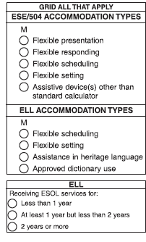
Recording Accommodations
For paper-based tests, record accommodations on the student grid sheet.

Slide 14
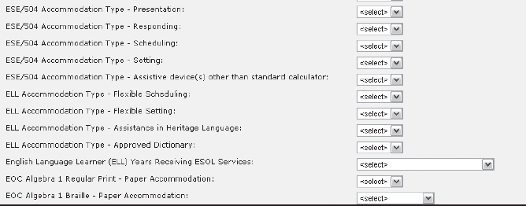
Recording Accommodations
For computer-based tests, record accommodations in PearsonAccess prior to the end of the administration window.

Slide 15
State Board of Education
Rule 6A-6.09091
Accommodations of the Statewide Assessment Program Instruments and Procedures for English Language Learners
Provides the following accommodations for ELLs:
  Flexible setting
  Assistance in heritage language
  Flexible scheduling/flexible timing
  Translation dictionary

Slide 16
Contact Information
Tamika Brinson
Bureau of K-12 Assessment
Tamika.Brinson@fldoe.org
(850) 245-0786
Leanne Grillot
Bureau of Exceptional Education and Student Services
Leanne.Grillot@fldoe.org
(850) 245-0478
Bureau of Student Achievement through Language Acquisition
SALA@fldoe.org
(850) 245-0417

Slide 17
Florida Alternate Assessment

Slide 18
Important Dates
Practice Materials and Manuals
  Ship to districts the week of September 6
  Braille/Tactile Graphic ship to districts week of September 13
One-sided and Braille materials for Spring assessment
  September 10 – October 12
*Note: The designated contact person to receive test materials will be notified when the window to order One-sided/Braille materials is open

Slide 19
Important Dates
Florida Alternate Assessment
Spring 2013 Testing Schedule
  Participation reporting: Survey 2, October 8-12, 2012
  Enrollment verification file: December 2012
  Materials shipped to districts: week of February 18, 2013
  Student testing window: February 25 – March 29, 2013
  Materials returned to Piedra: no later than April 5, 2013

Slide 20
Answer Sheet Errors
Three main errors that can impact scoring and student results
  Incomplete Academic Area (N=270)
    One or more items was left blank
  Too Many Marks (N=38)
    More than one bubble was completed for a specific item
  Incorrect Academic Area (N=56)
    An incorrect area was completed for a student’s grade-level (e.g., Writing for a 5th grader, Reading for an 11th grader)

Slide 21
Reading Results

Slide 22
Mathematics Results

Slide 23
Writing Results

Slide 24
Science Results

Slide 25
New Assessment
Florida is a member of the National Center and State Collaborative Consortium for Alternate Assessment based on Alternate Achievement Standards
New assessment aligned to the CCSS planned for Spring 2015

Slide 26
FAA Contact Information
Karen Denbroeder
Bureau of Exceptional Education and Student Services
Karen.Denbroeder@fldoe.org
(850) 245-0475
Angela Nathaniel
Bureau of Exceptional Education and Student Services
Angela.Nathaniel@fldoe.org
(850) 245-0475

