Slide 1


Why Audiobooks Don’t Work
And All the Reasons
Why They Do

Slide 2
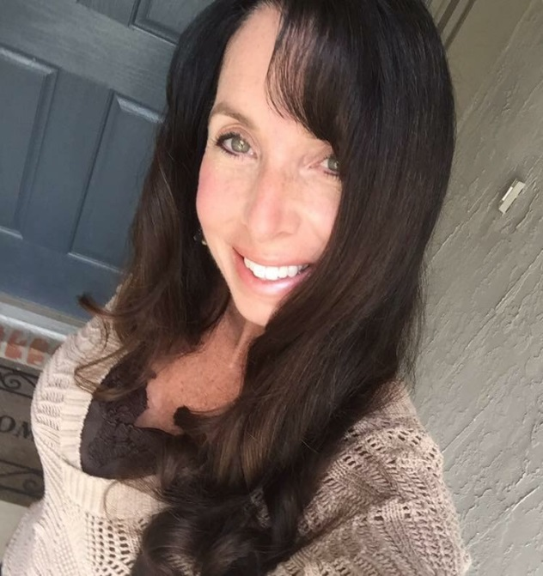
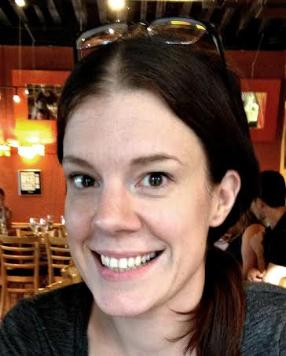
Program Manager-Florida Grant
Kimberlie Hiler

Slide 3
Agenda
About Learning Ally
- LA facts and figures
- Ways LA supports teachers, students, and parents
Eligibility and Audiobook Access
- Eligibility Requirements for students
- Learning Ally Audiobook Access
Teacher Ally -Online student management portal and resource center
- “Get Started” page
Link App- Free App for iOS, Android, Chrome App Store
- Demo

Slide 4





Learning Ally Solution
Supporting Your Schools
Supporting Your Teachers
AUDIOBOOK
LIBRARY
Supporting Your Students
Supporting Your Parents/Caregivers

Slide 5
Florida DOE Grant membership
Through the partnership of the Florida Department of Education and Learning Ally, public and charter schools in Florida can enroll to have access to Learning Ally’s library of over 80,000 audio textbooks and literature titles for qualifying K-12 students at no cost to your district.

Slide 6

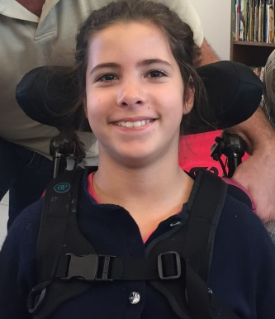
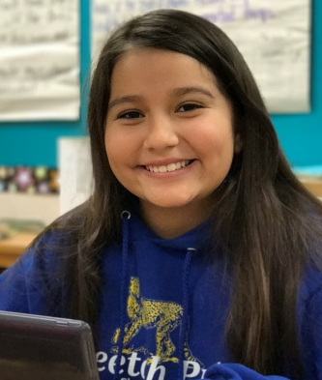
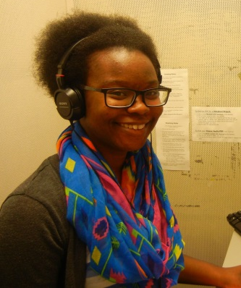
Certification & Eligibility
“Qualified Individuals” are those persons who exhibit the characteristics of a learning disability as certified by a Competent Authority in accordance with the “Chafee amendment”.
Specific Learning Disability - Students who have a specific learning disability, meaning a disorder in 1 or more of the basic psychological processes involved in understanding or in using language, spoken or written, which may manifest itself in the imperfect ability to listen, think, speak, read, write, spell, or do mathematical calculations. It includes conditions such as perceptual disabilities, brain injury, minimal brain dysfunction, dyslexia, and developmental aphasia. Students in this category often have SLD on their IEP or have a diagnosed learning disability.
Reading Accommodation - Students who struggle with reading, who are not responding to instructional interventions, or who need a reading accommodation to keep up with course content while working to improve reading skills. A Competent Authority should conduct student observations, assessments, and a review of student work to determine if the student’s reading skill deficits are consistent enough to prohibit accessing standard texts at the expected benchmarks for the student’s grade.
Blind or Visually Impaired - Students who are blind or visually impaired.
Other Physical Disability - Students who have a physical impairment that prevents them from reading standard print, such as can’t hold a book, turn the pages of a book, etc.

Slide 7
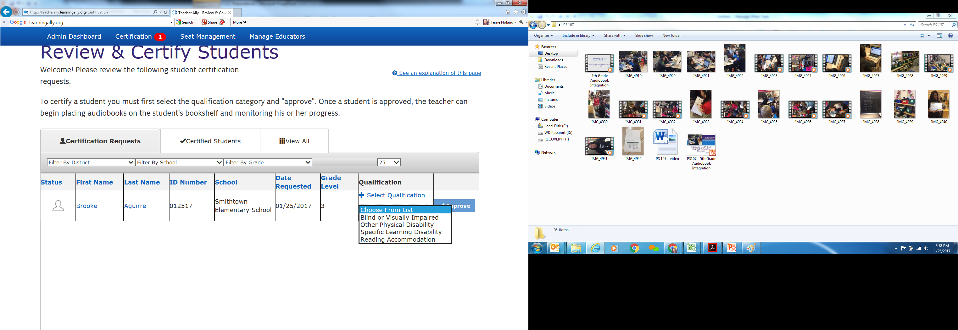
Certification tab

Slide 8


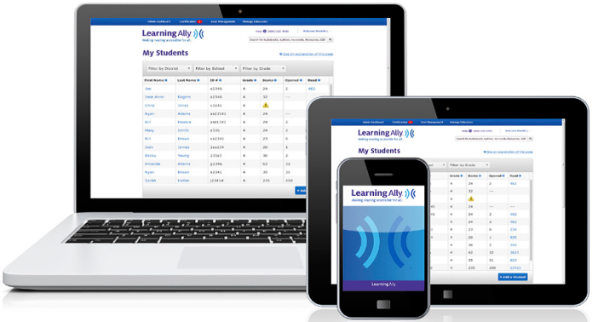
Audiobooks
Unlimited Year Round Access for Qualified students
Unlimited access to audiobooks
Unlimited access to Learning Ally Link for
- iOS devices (App Store)
- PC/MAC/Chromebook
(Chrome App store)
- Android Devices (Google Play)

Slide 9
Registering your schools
Easy online registration
www.learningally.org/florida
Click on Enroll Now
Once application is processed, contacts will receive user name and password
Easy to enroll other educators at school

Slide 10
4 Easy Steps
1
  Add Students
2
  Certify Students
3
  Assign Books
4
  Track Progress
www.learningally.org/getstarted

Slide 11
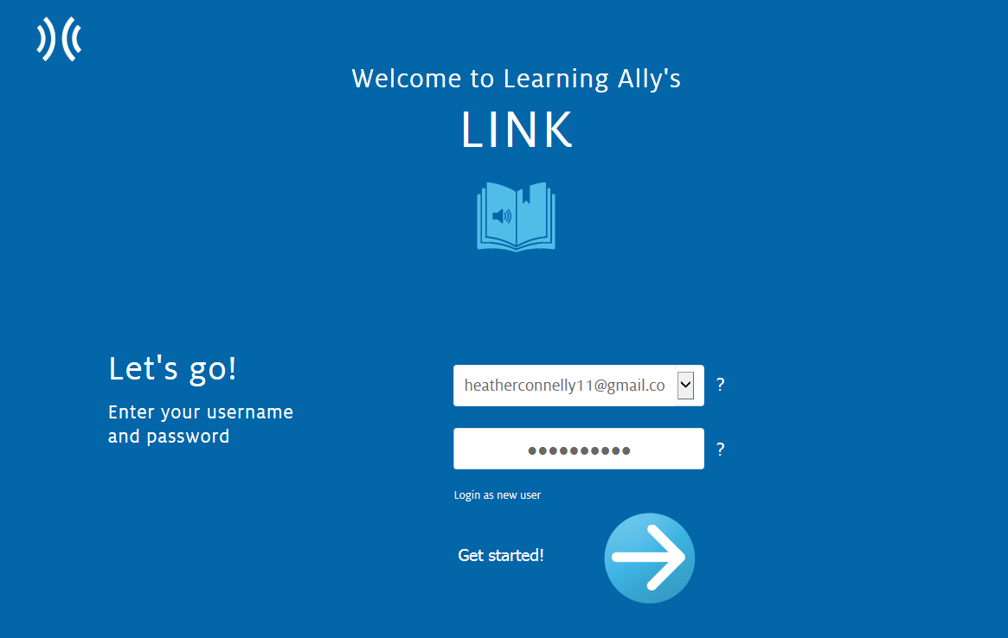
Learning Ally LINK Demo
http://learningally.org/link

Slide 12
Next Steps:
Go to www.learningally.org/getstarted for guides, step-by-step instructions, videos, webinar information, and more on how to get started!
After logging in on www.learningally.org, Click on the Resources tab to see Teacher Resource Materials, student to student videos, and ideas on how to help struggling readers read.
Encourage 20 minutes of reading a day to help your students reach their ultimate potential.
Share your stories of success with us! E-mail khiler@learningally.org to share how your students are making gains using Learning Ally.
Questions? Do you need additional help?
Contact Kimberlie Hiler @ khiler@learningally.org

