Slide 1
Discipline

Slide 2
2016 Dear Colleague Letter
Schools should take care when implementing exclusionary disciplinary measures that significantly interfere with a child’s instruction and participation in other school activities. In some schools, staff are properly trained to implement and document measures such as the use of study carrels, time outs, and restrictions in privileges, in a manner consistent with a child’s right to FAPE.27 However, in other schools, staff may not be properly trained in the appropriate use of these measures; consequently, their improper use of these measures could rise to the level of a disciplinary removal. These exclusionary disciplinary measures also could include:
  A pattern of office referrals, extended time excluded from instruction (e.g., time out), or extended restrictions in privileges;
  Repeatedly sending children out of school on “administrative leave” or a “day off” or other method of sending the child home from school;
  Repeatedly sending children out of school with a condition for return, such as a risk assessment or psychological evaluation; or
  Regularly requiring children to leave the school early and miss instructional time (e.g., via shortened school days).
Notes:
Review 2016 OSEP Dear Colleague Letter related to discipline practices and links with lost instructional time.

Slide 3
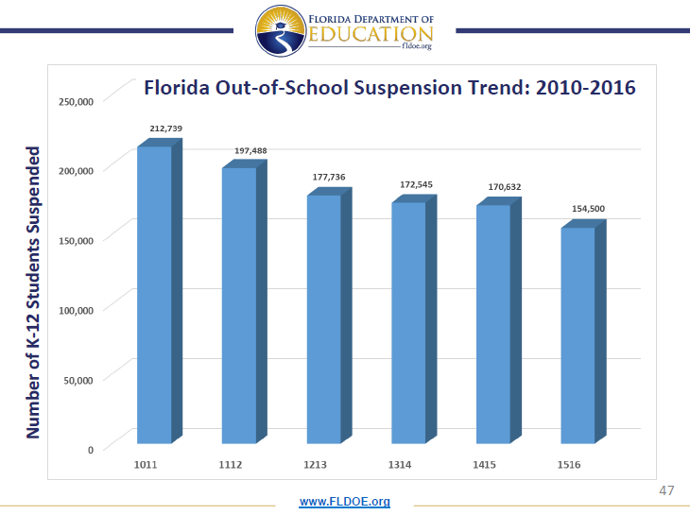
Notes:
Overall numbers of FL students suspended from 10/11 to 15/16 school year

Slide 4
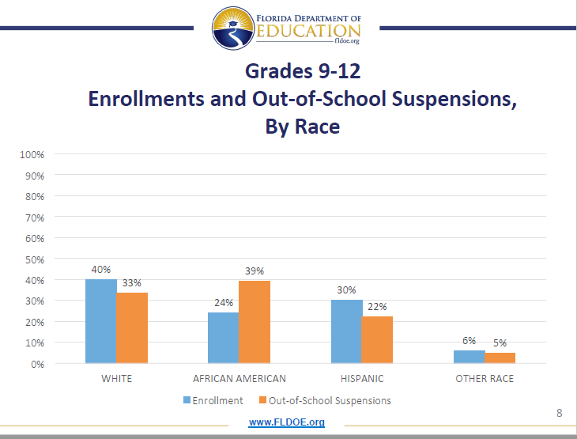
Notes:
Data shared by Vice Chancellor Oliva on comparison of racial/ethnic subgroups suspensions versus representation in population among high school students. Significant disparity between representation in population and suspension rates for Black/African-American students.

Slide 5
14/15 FL SWD Suspensions- (Ages 3-21)
https://www2.ed.gov/programs/osepidea/618-data/static-tables/index.html#partb-dis
Notes:
14/15 SY data related to number of students with disabilities with in and out-of-school suspensions totaling 10 or fewer days and 11+ days.
Data from: https://www2.ed.gov/programs/osepidea/618-data/static-tables/index.html#partb-dis

Slide 6
Suspensions and FL 9th Graders
Notes:
Data from Balfanz Byrnes, & Fox (2012) study on impact of suspensions among FL 9th graders. Article available in wiki

Slide 7
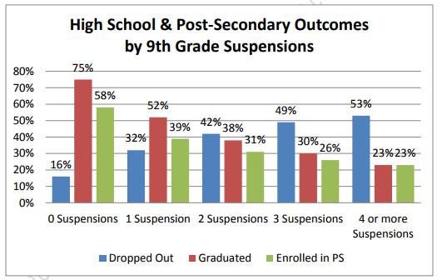
Student Outcomes
Balfanz, Byrnes, & Fox (2012)
Notes:
The impact of even 1 suspension decreases graduation rates by 23%, doubles dropout rates and reduces post-secondary enrollment by 19%

Slide 8
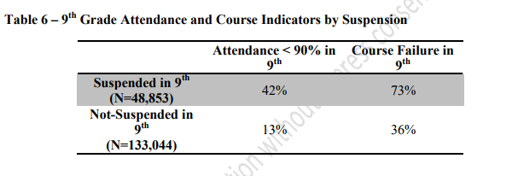
Suspensions and Early Warning Indicators
Balfanz, Byrnes, & Fox (2012)
Notes:
Much greater likelihood of other early warning indicators among those that were suspended.

